Slide 1
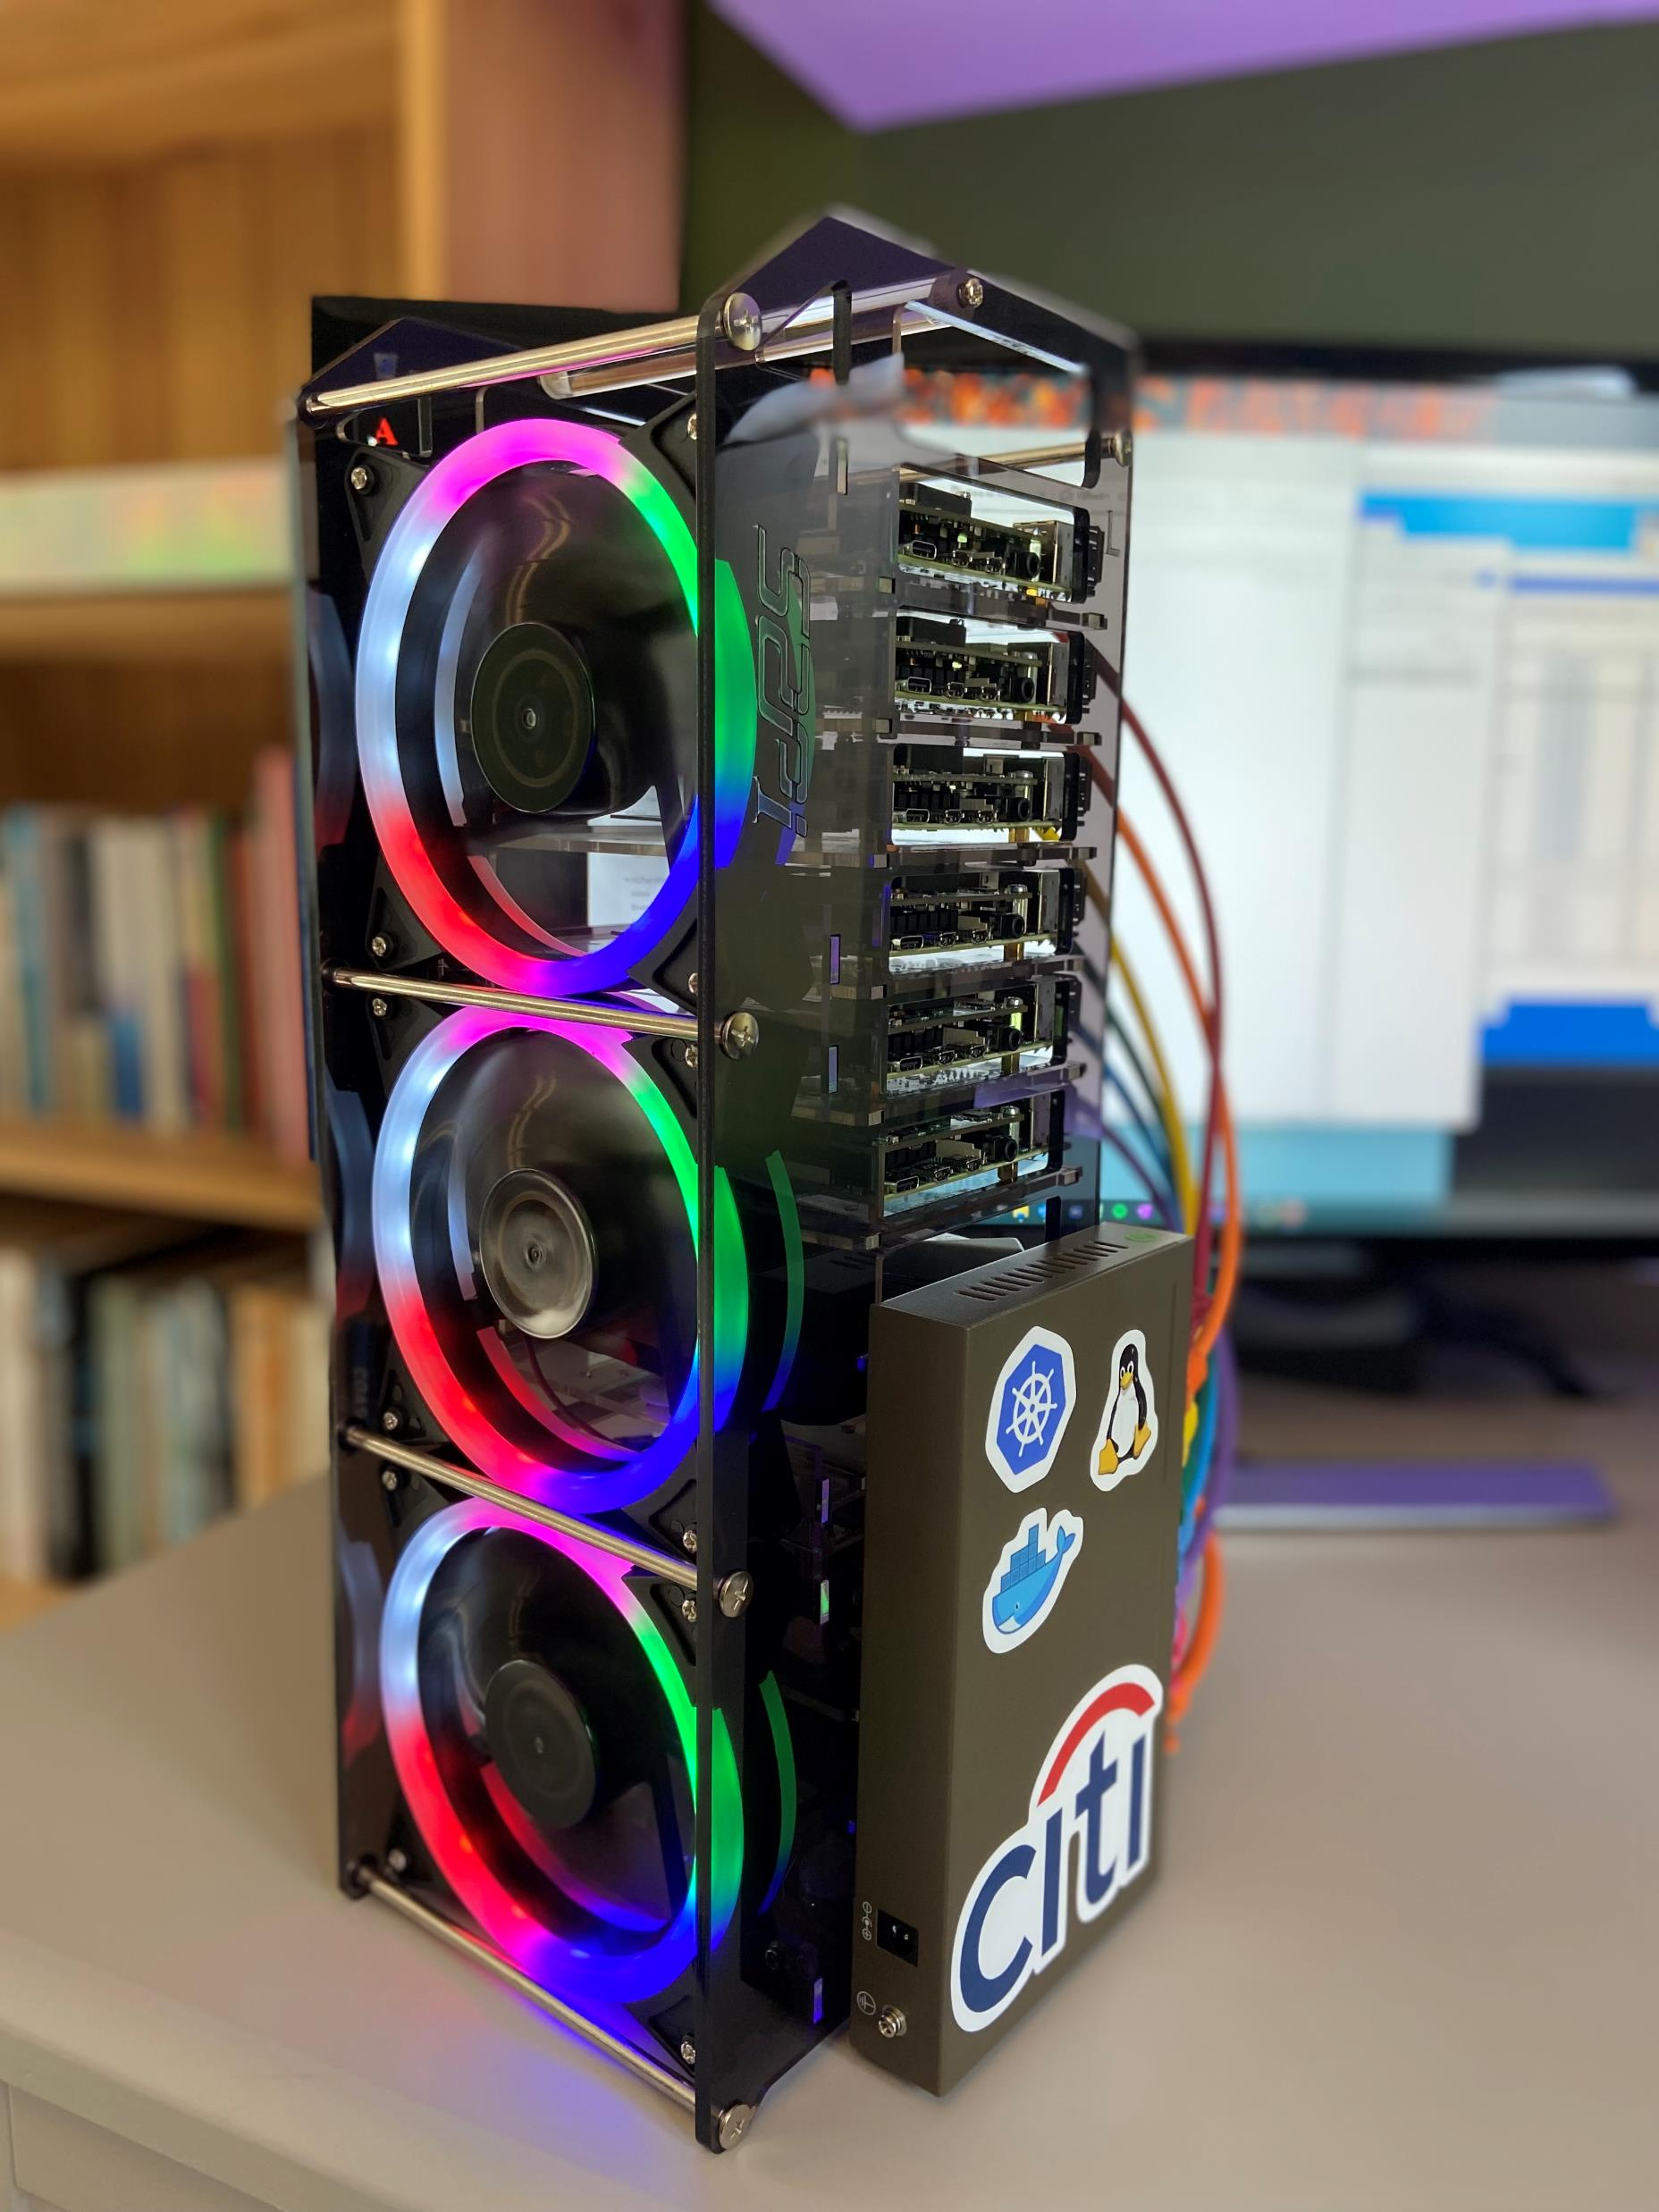
Raspberry Pi Kubernetes Cluster (Assembly Guide)

Slide 2
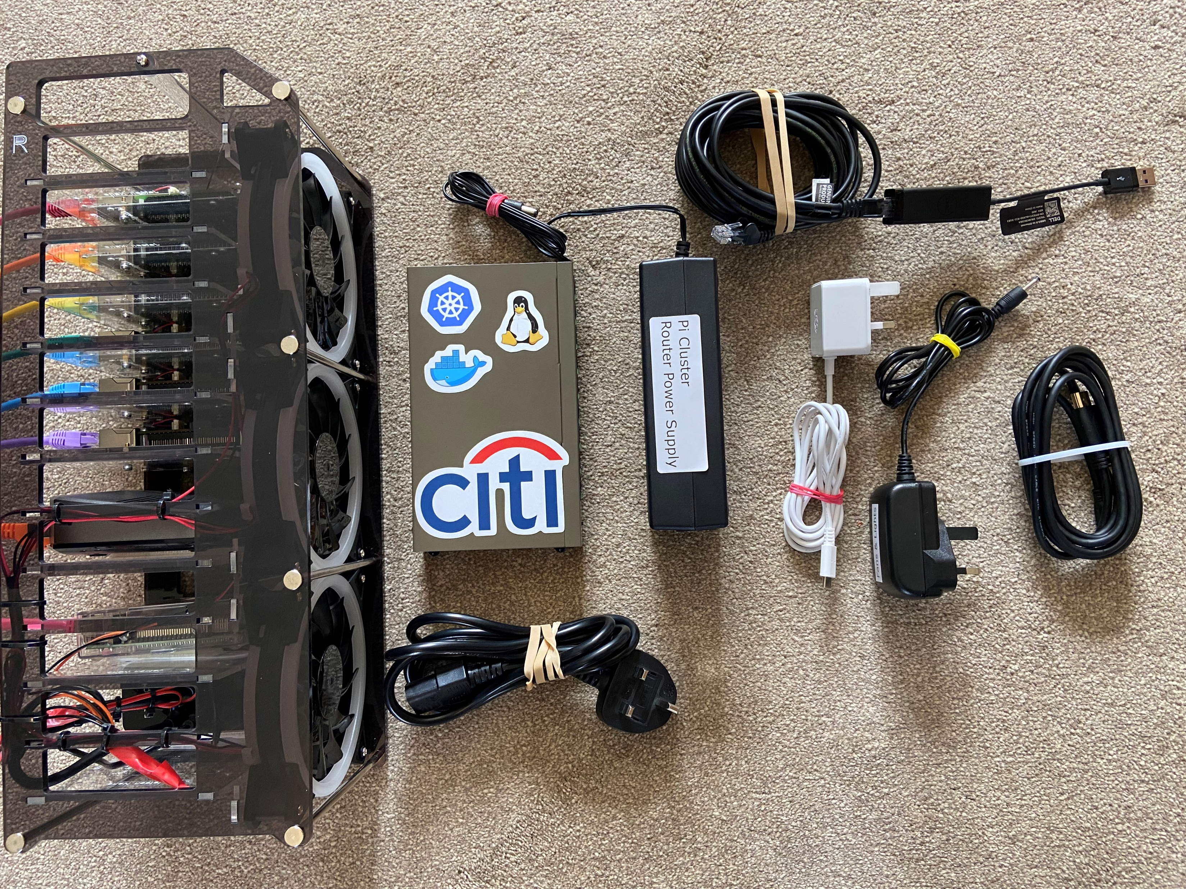
POE Network Switch
Switch PSU
CAT Cable for Laptop with USB Adaptor
Cluster Rack
Micro HDMI
Power Supply for
Fans/Lights and Gateway Pi
Switch PSU Power Cord
USB-C Power Supply for Controller Pi

Slide 3
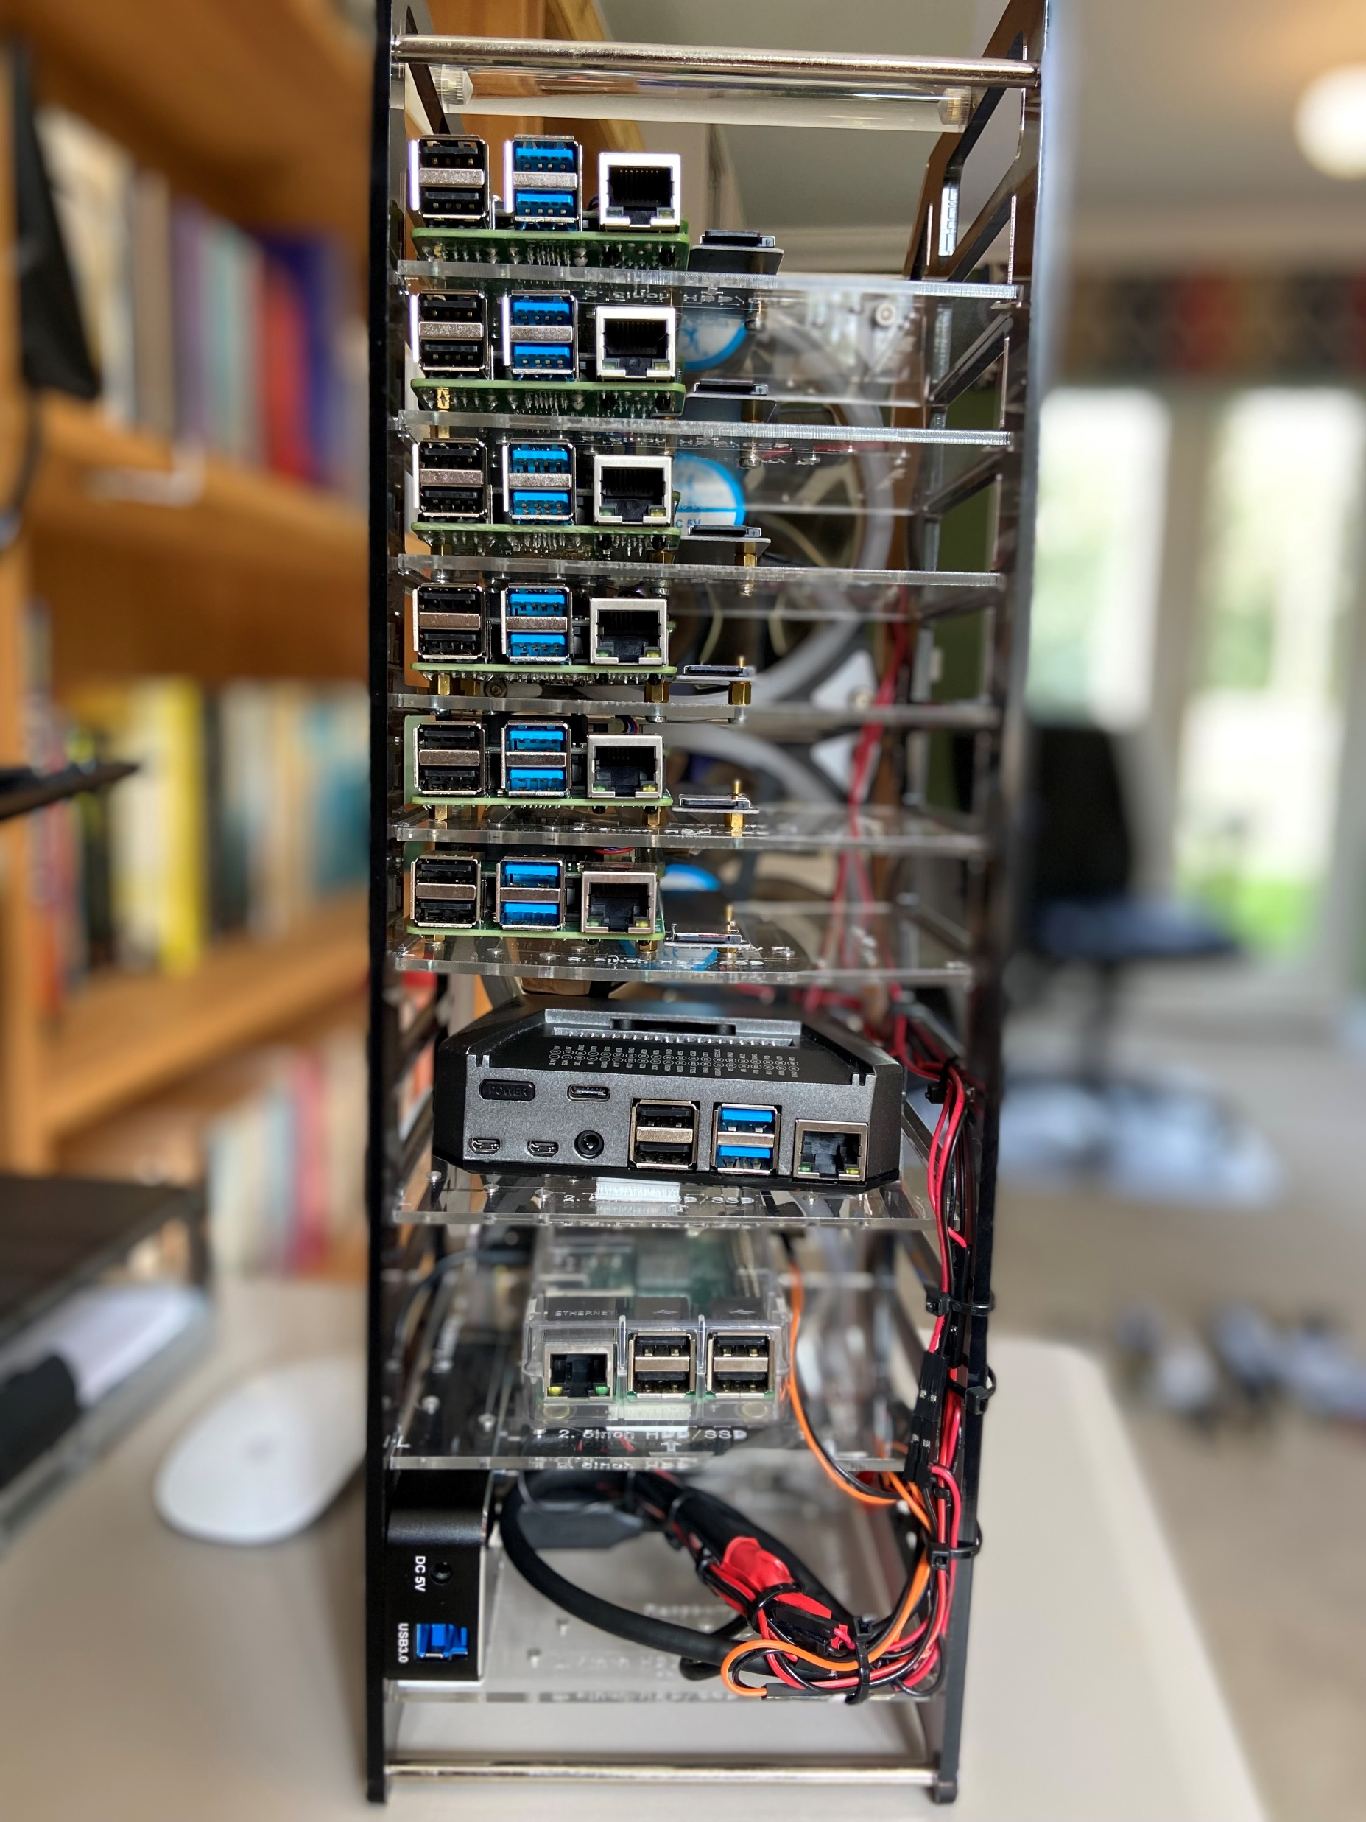
Worker Pi 0 Raspberry Pi 4B (4 CPU, 8 GB RAM each)
Worker Pi 2
Worker Pi 3
Worker Pi 4
Worker Pi 5
Controller Pi – IP 10.0.0.80
Kubernetes controller node + Ansible bastion host
Gateway host (Pi 3)
USB power supply, powers the fans, lights and the gateway Pi

Slide 4
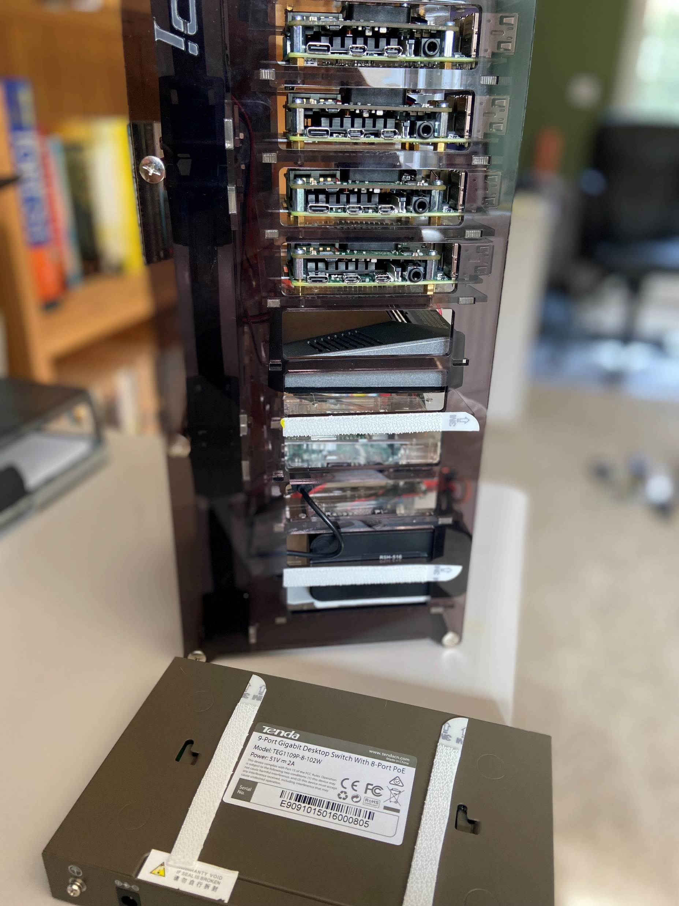
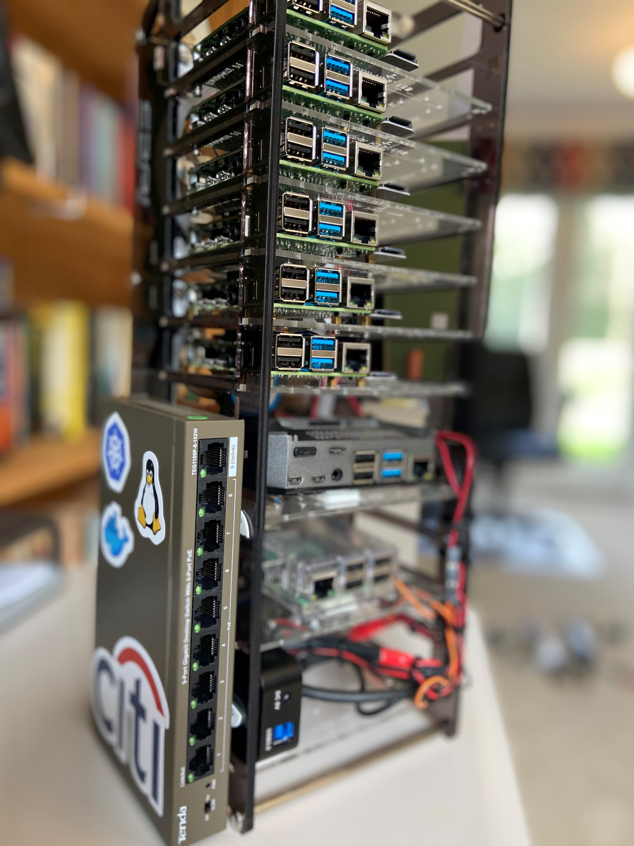
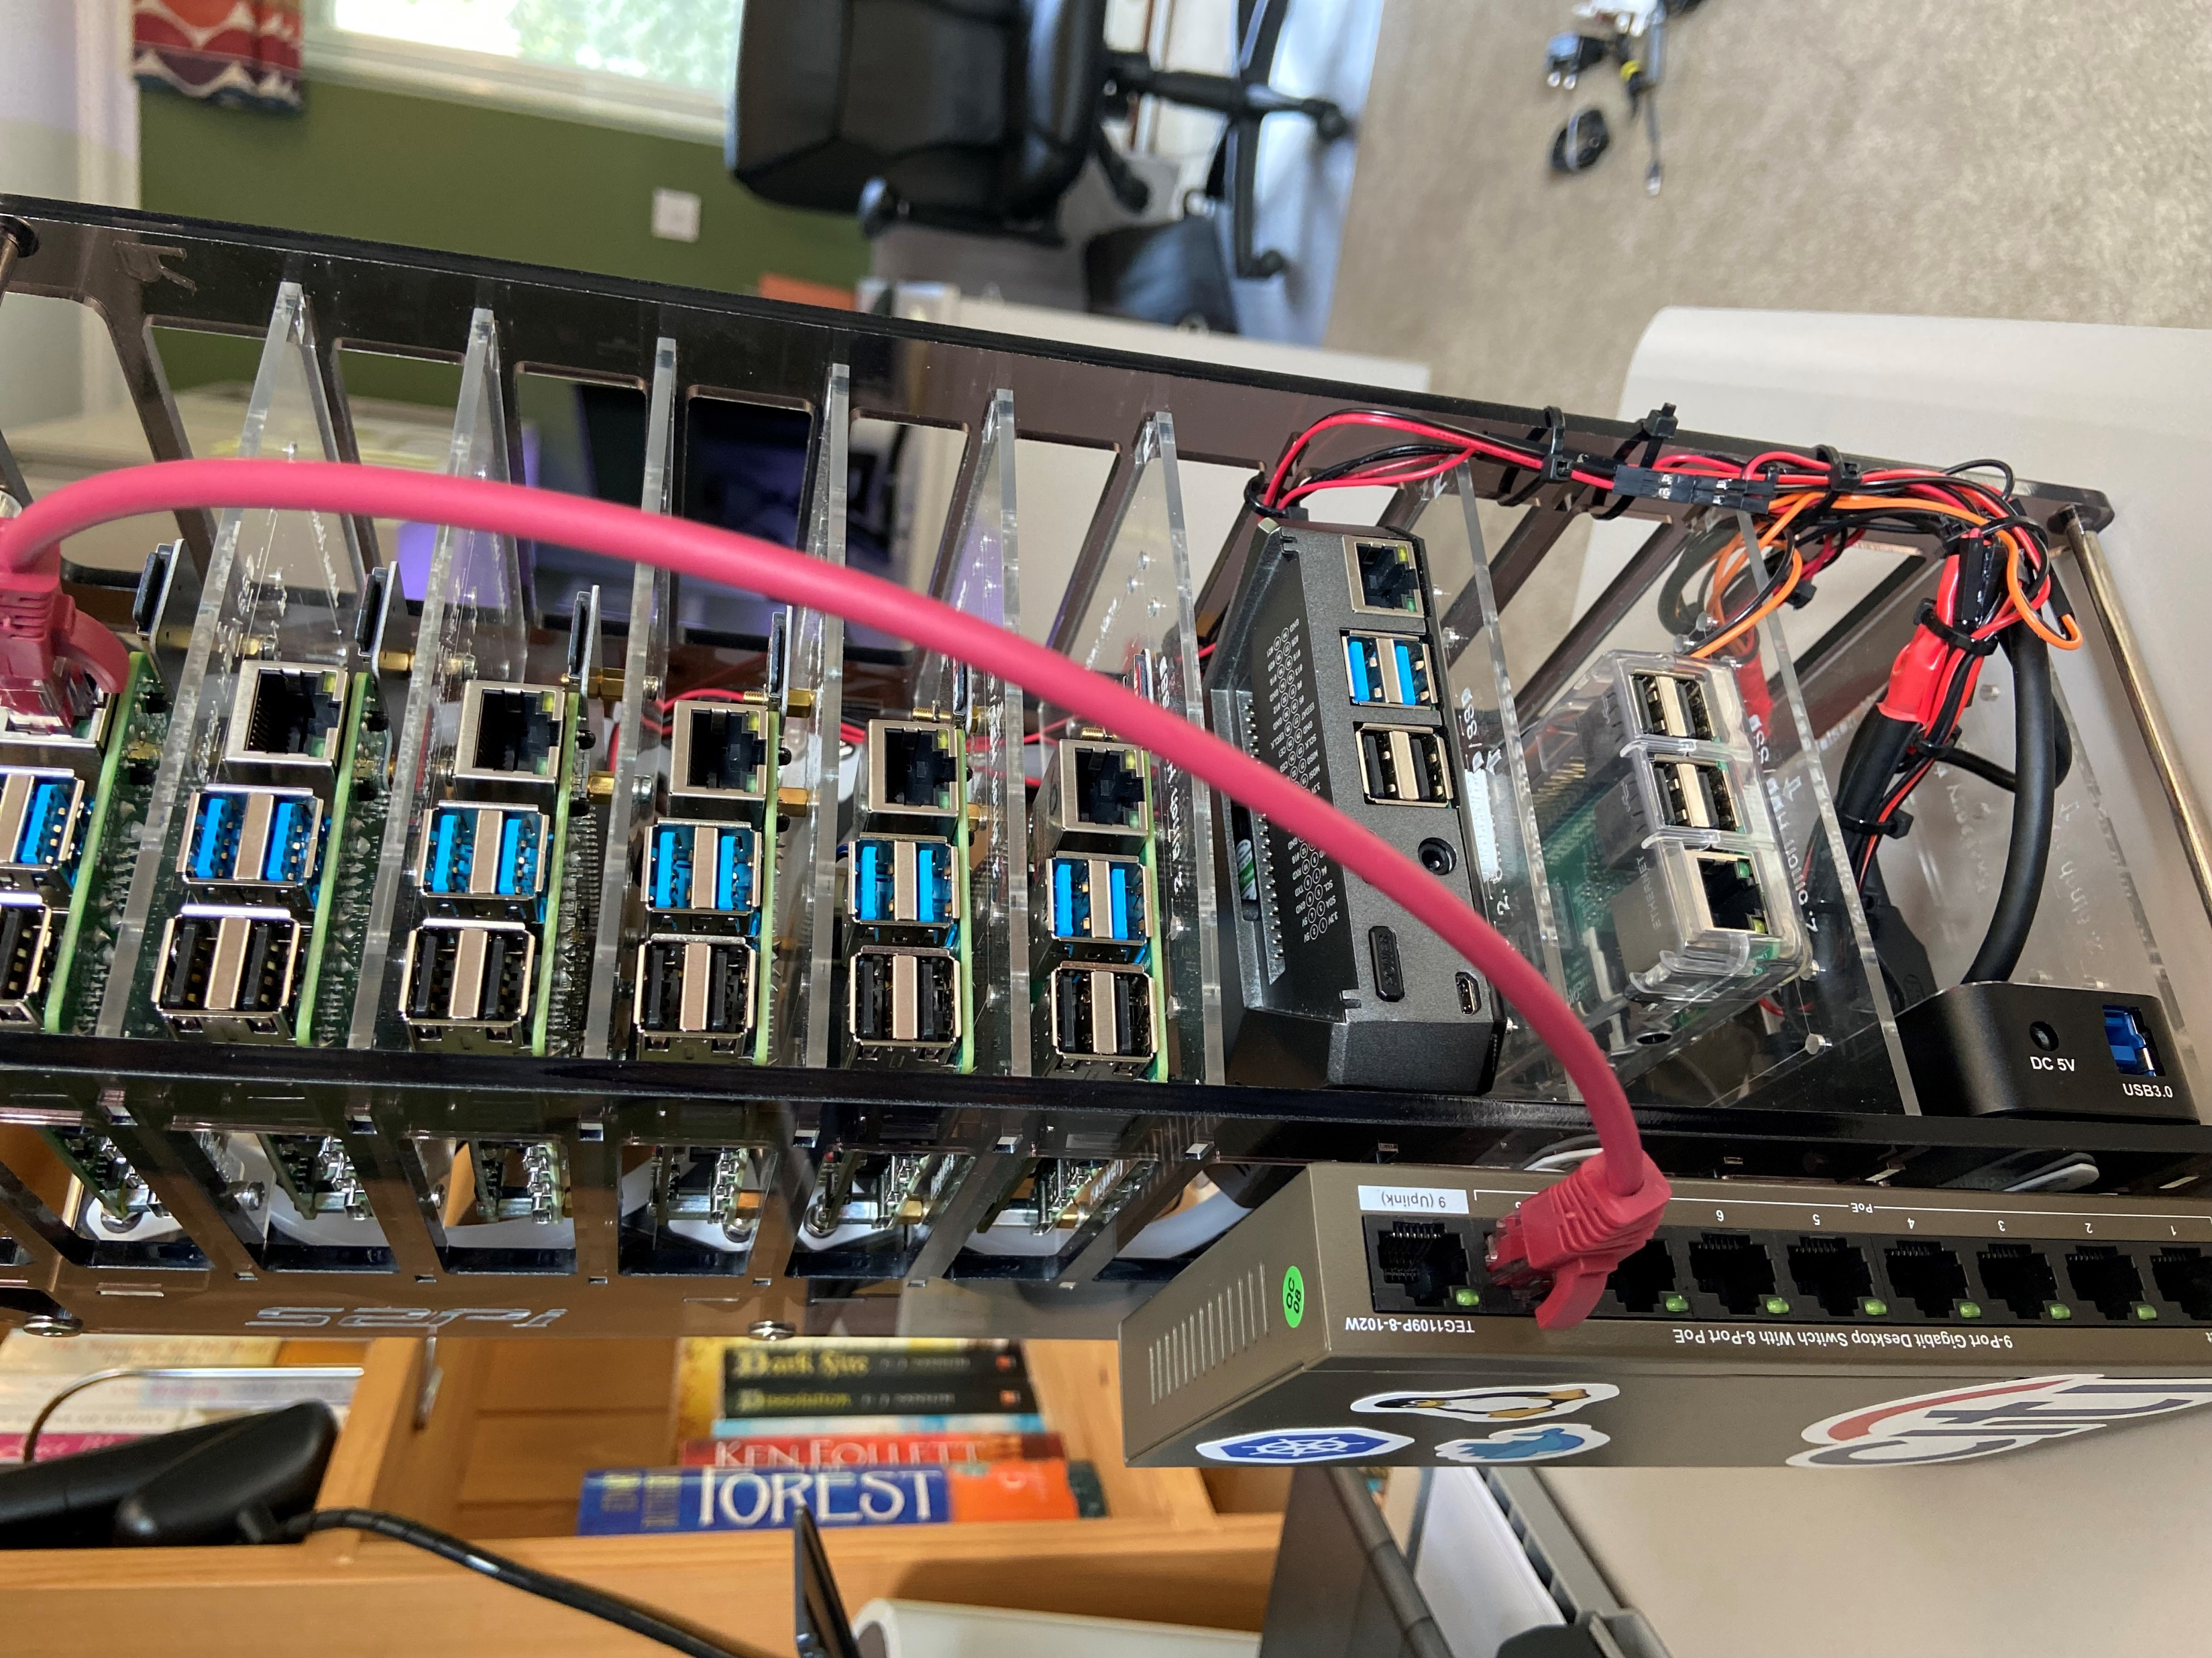
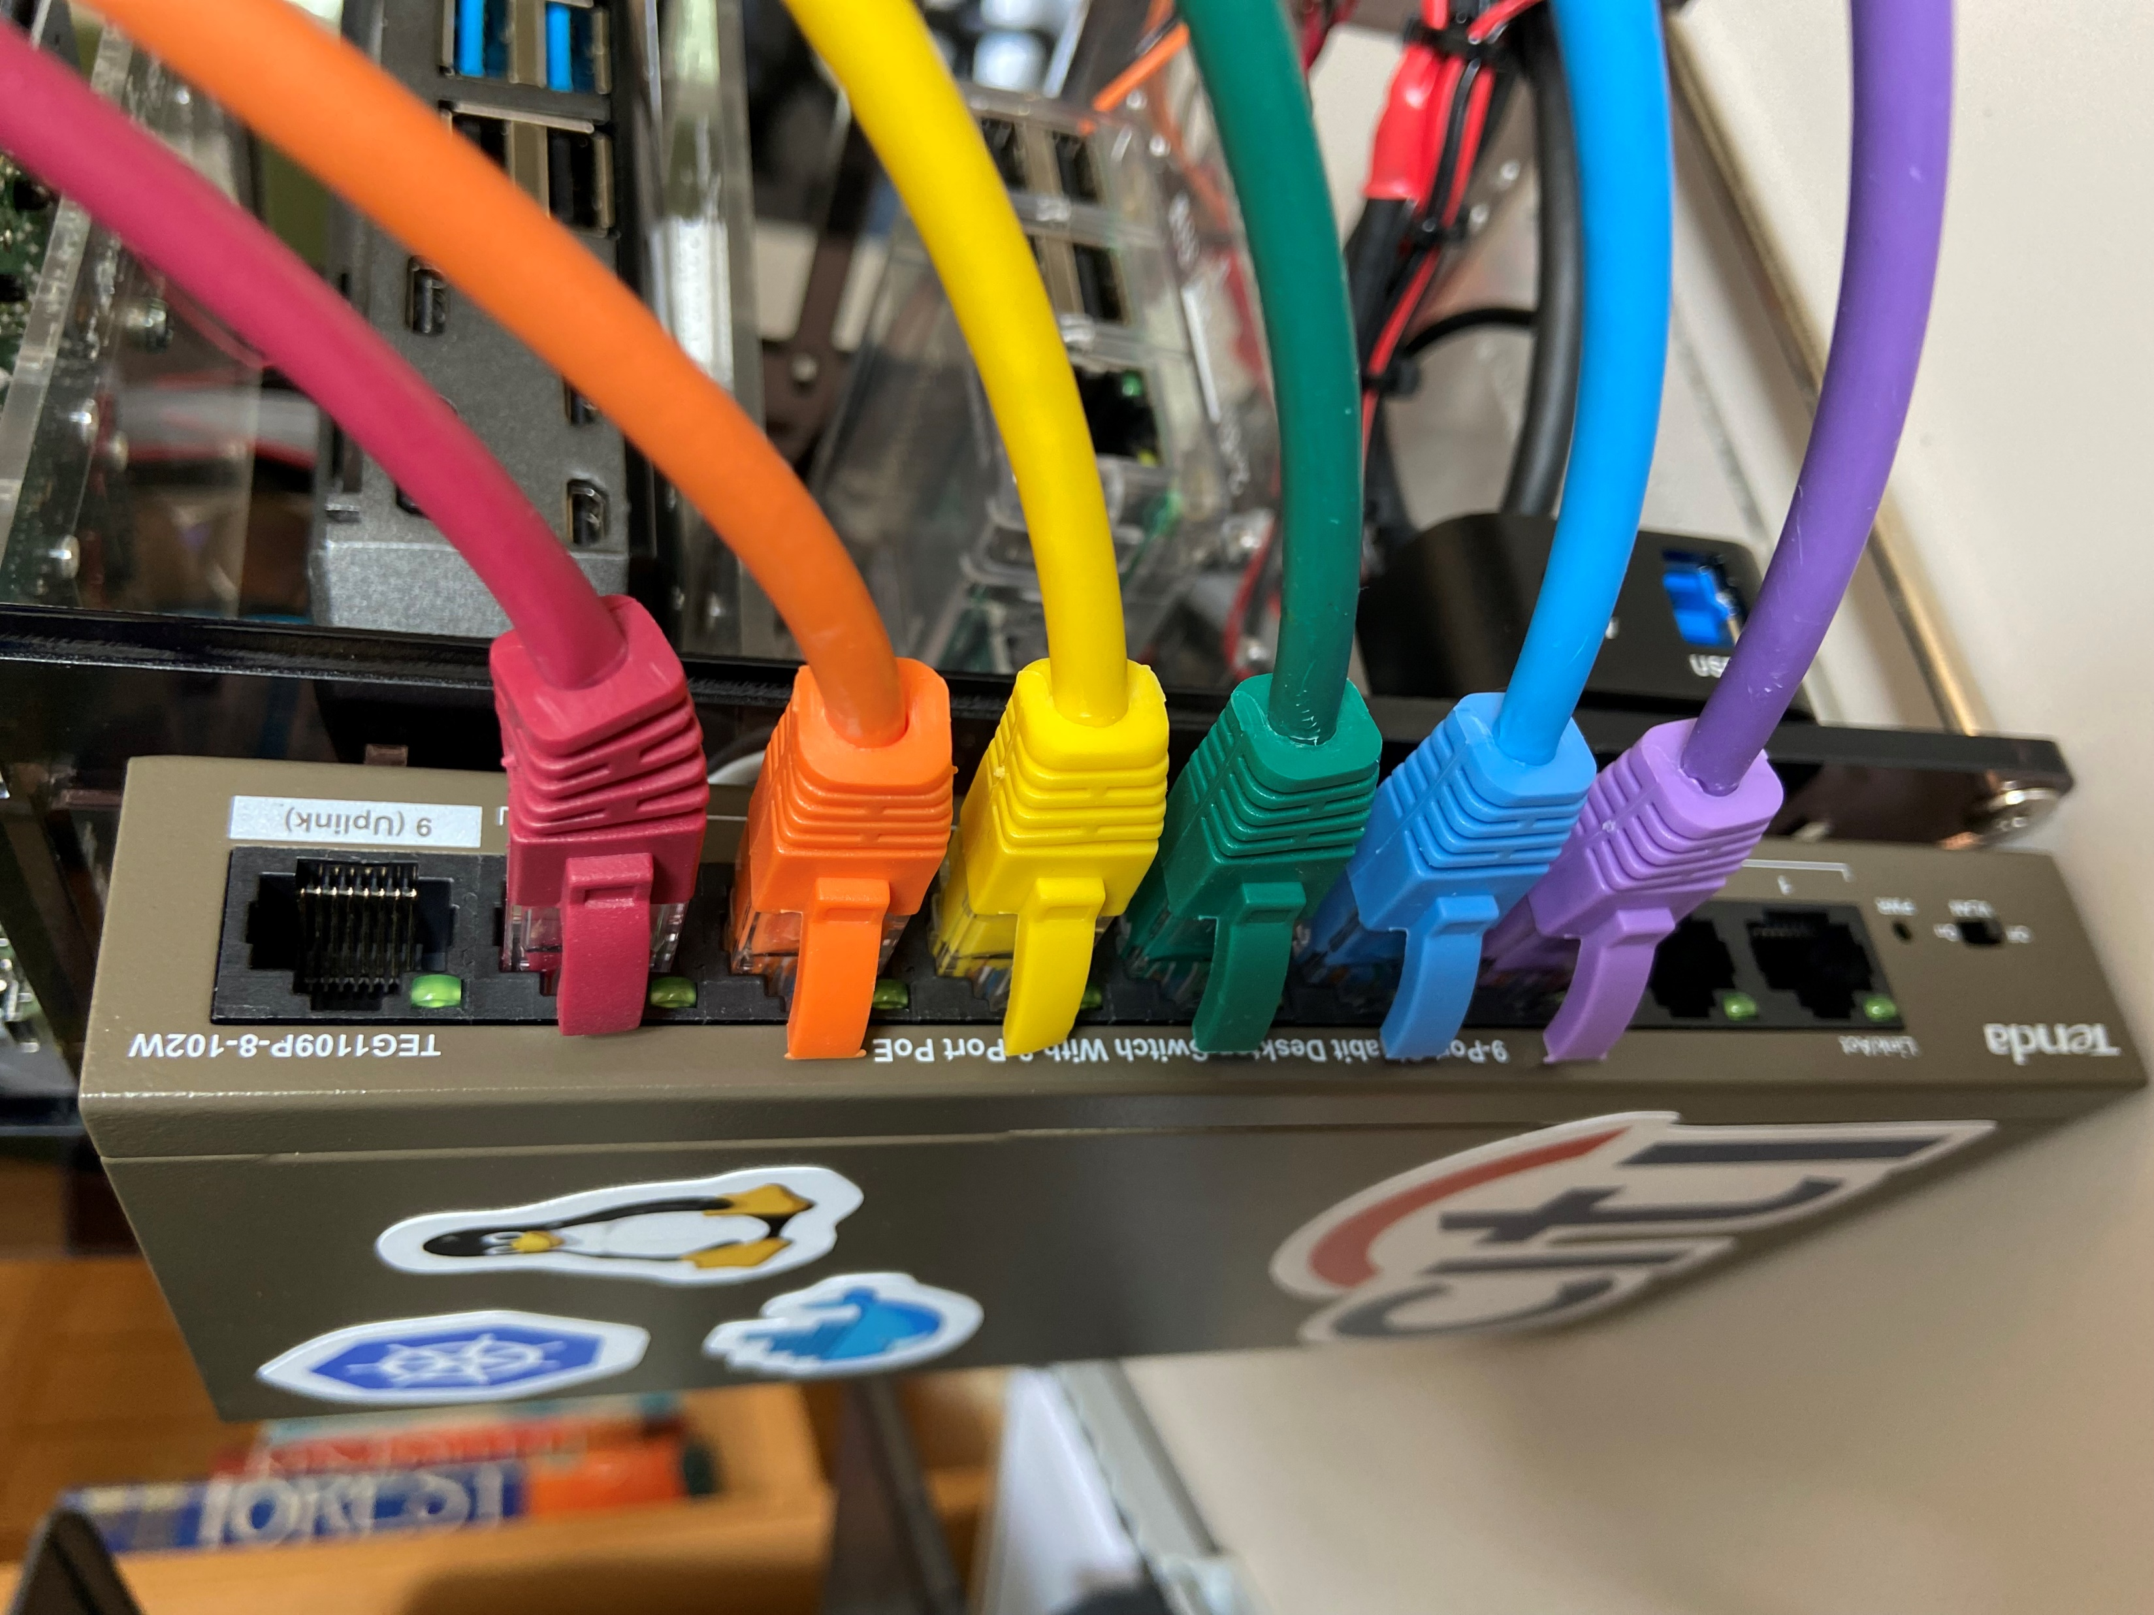
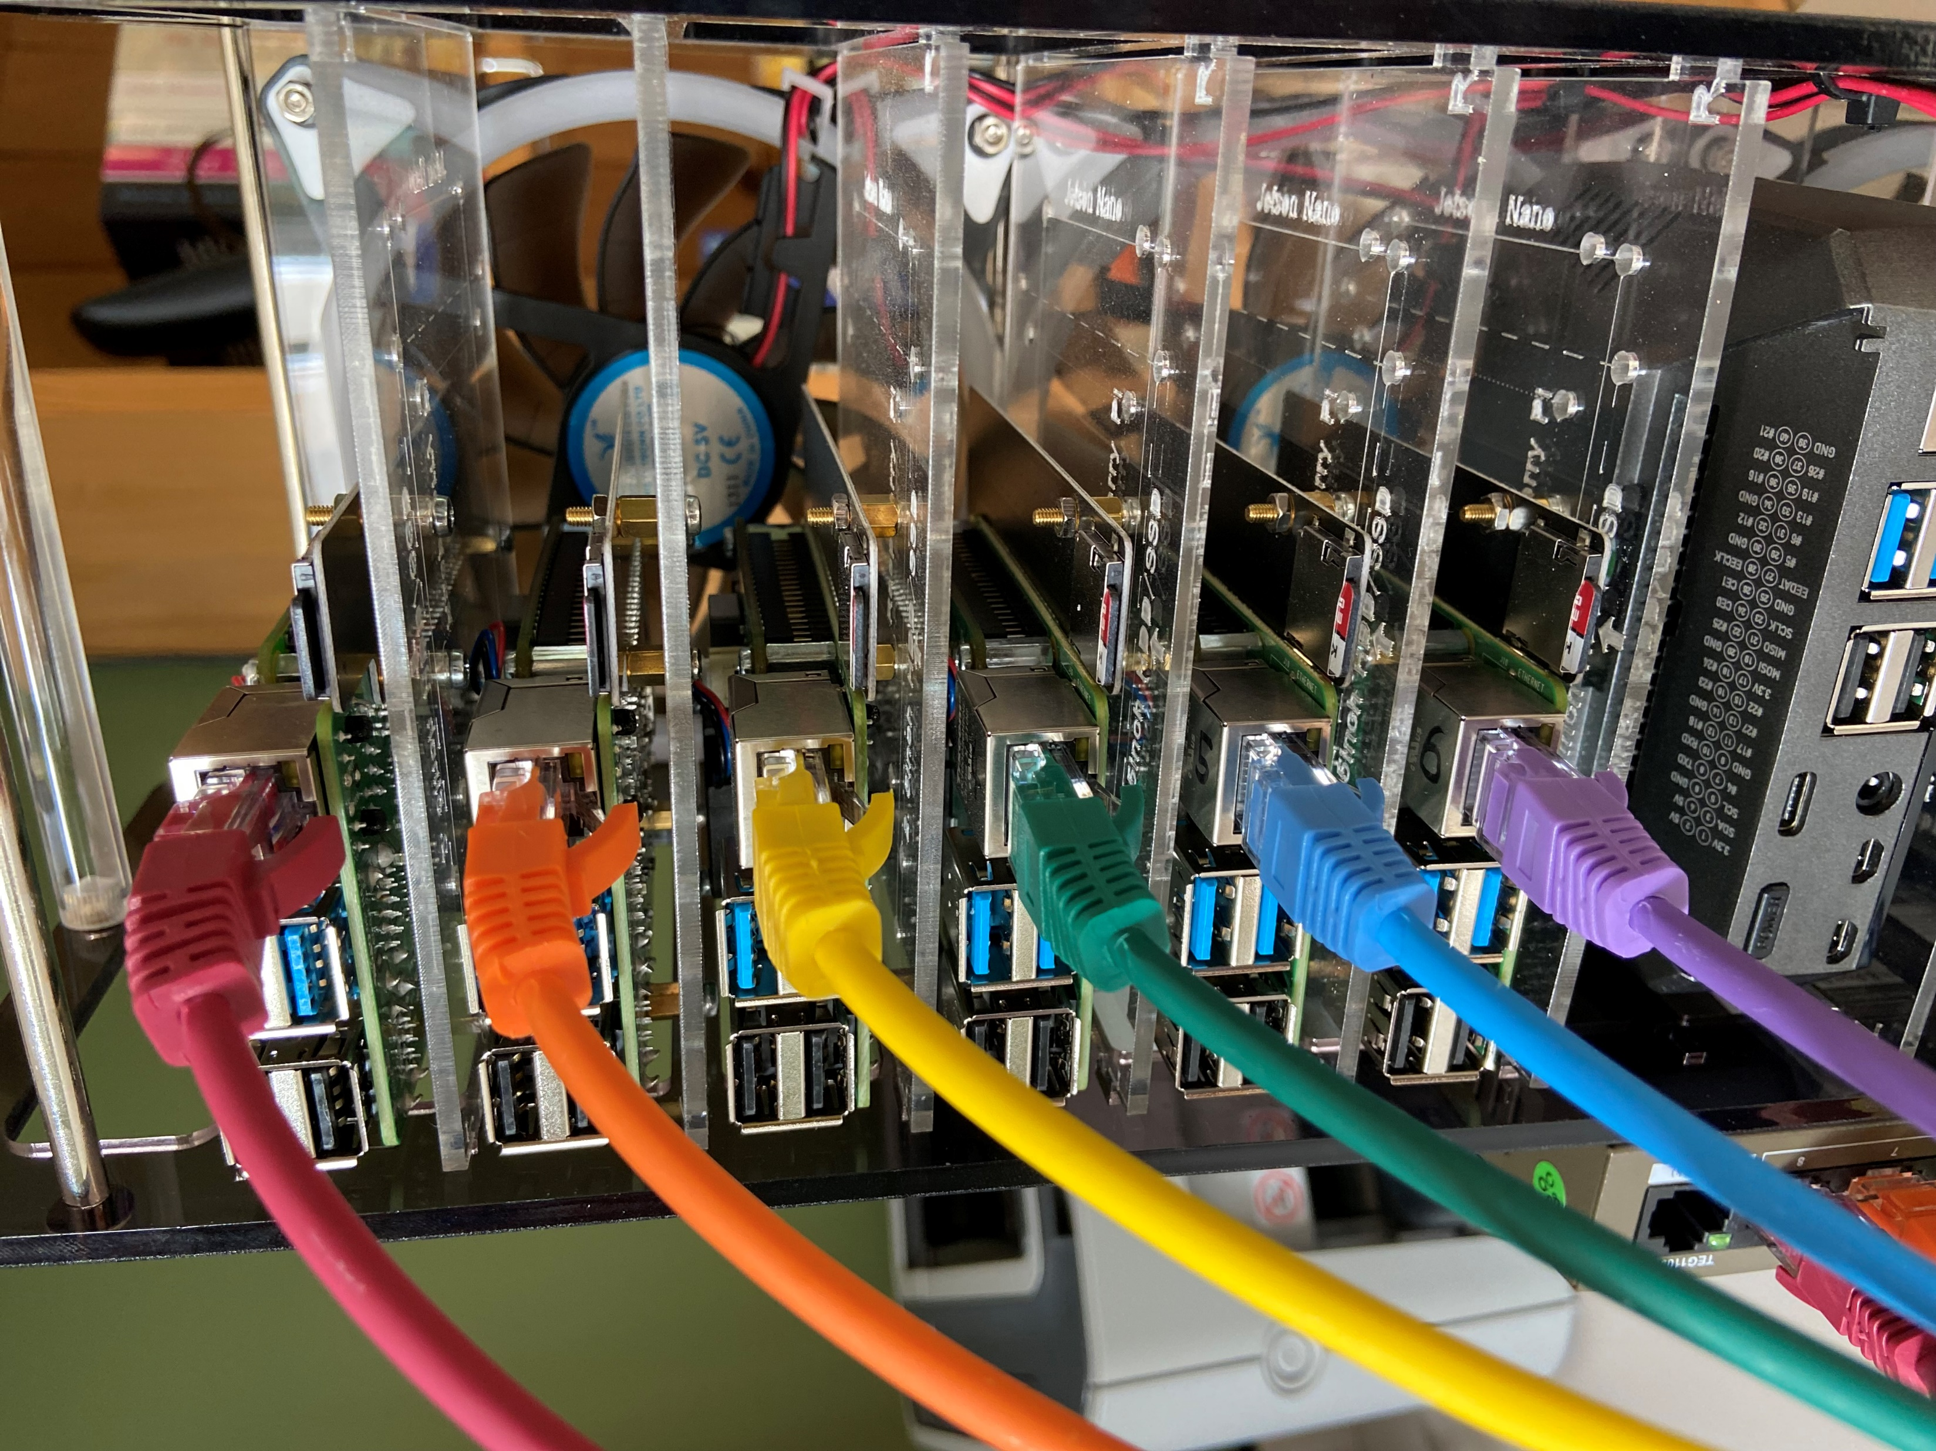
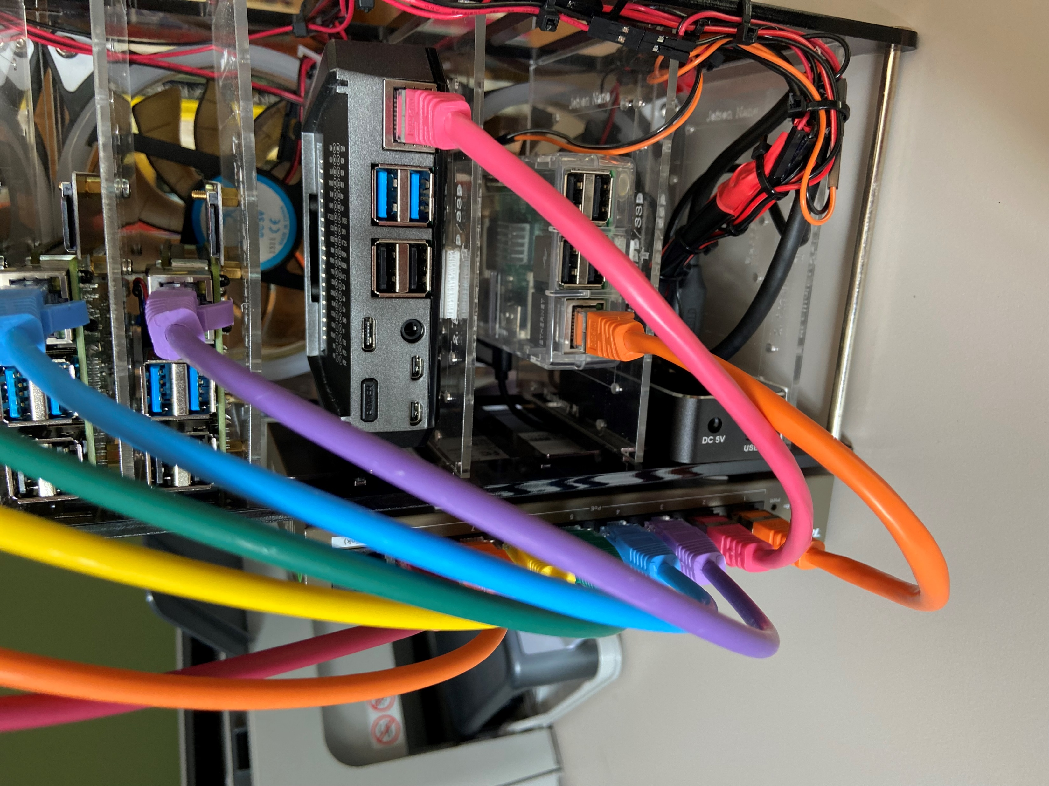
Connect each Pi to the switch with a coloured CAT lead, rainbow order! ROYGBI
(These colours appear in the Pod Invaders game)
1
2
Use Velcro pad to attach network switch to chassis
Next, connect the controller and gateway Pis to the bottom 2 sockets
Note – leave the first network socket free (labelled “uplink”), this is for external connectivity e.g. a laptop
3

Slide 5
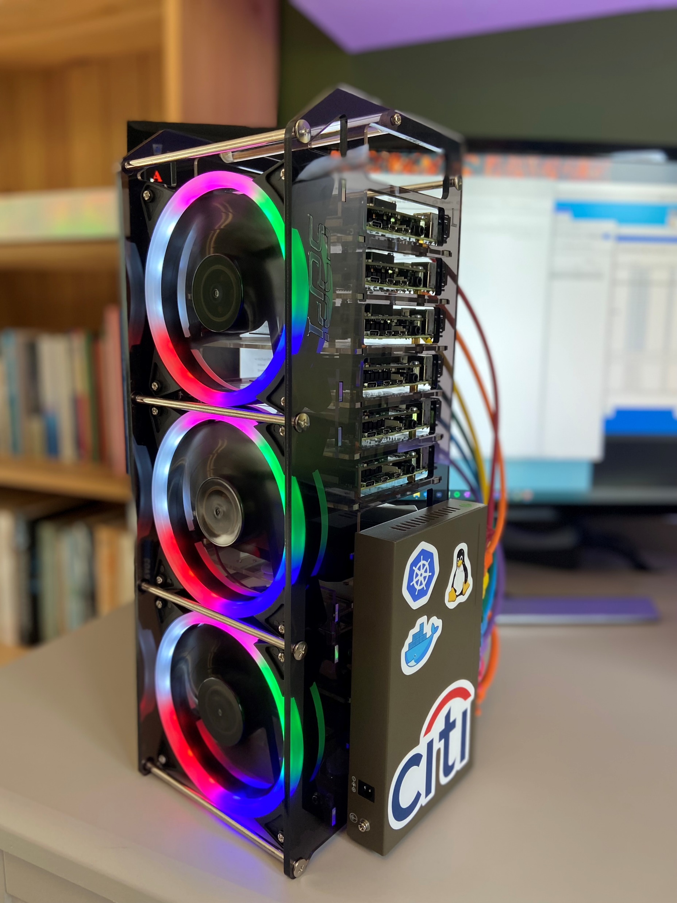
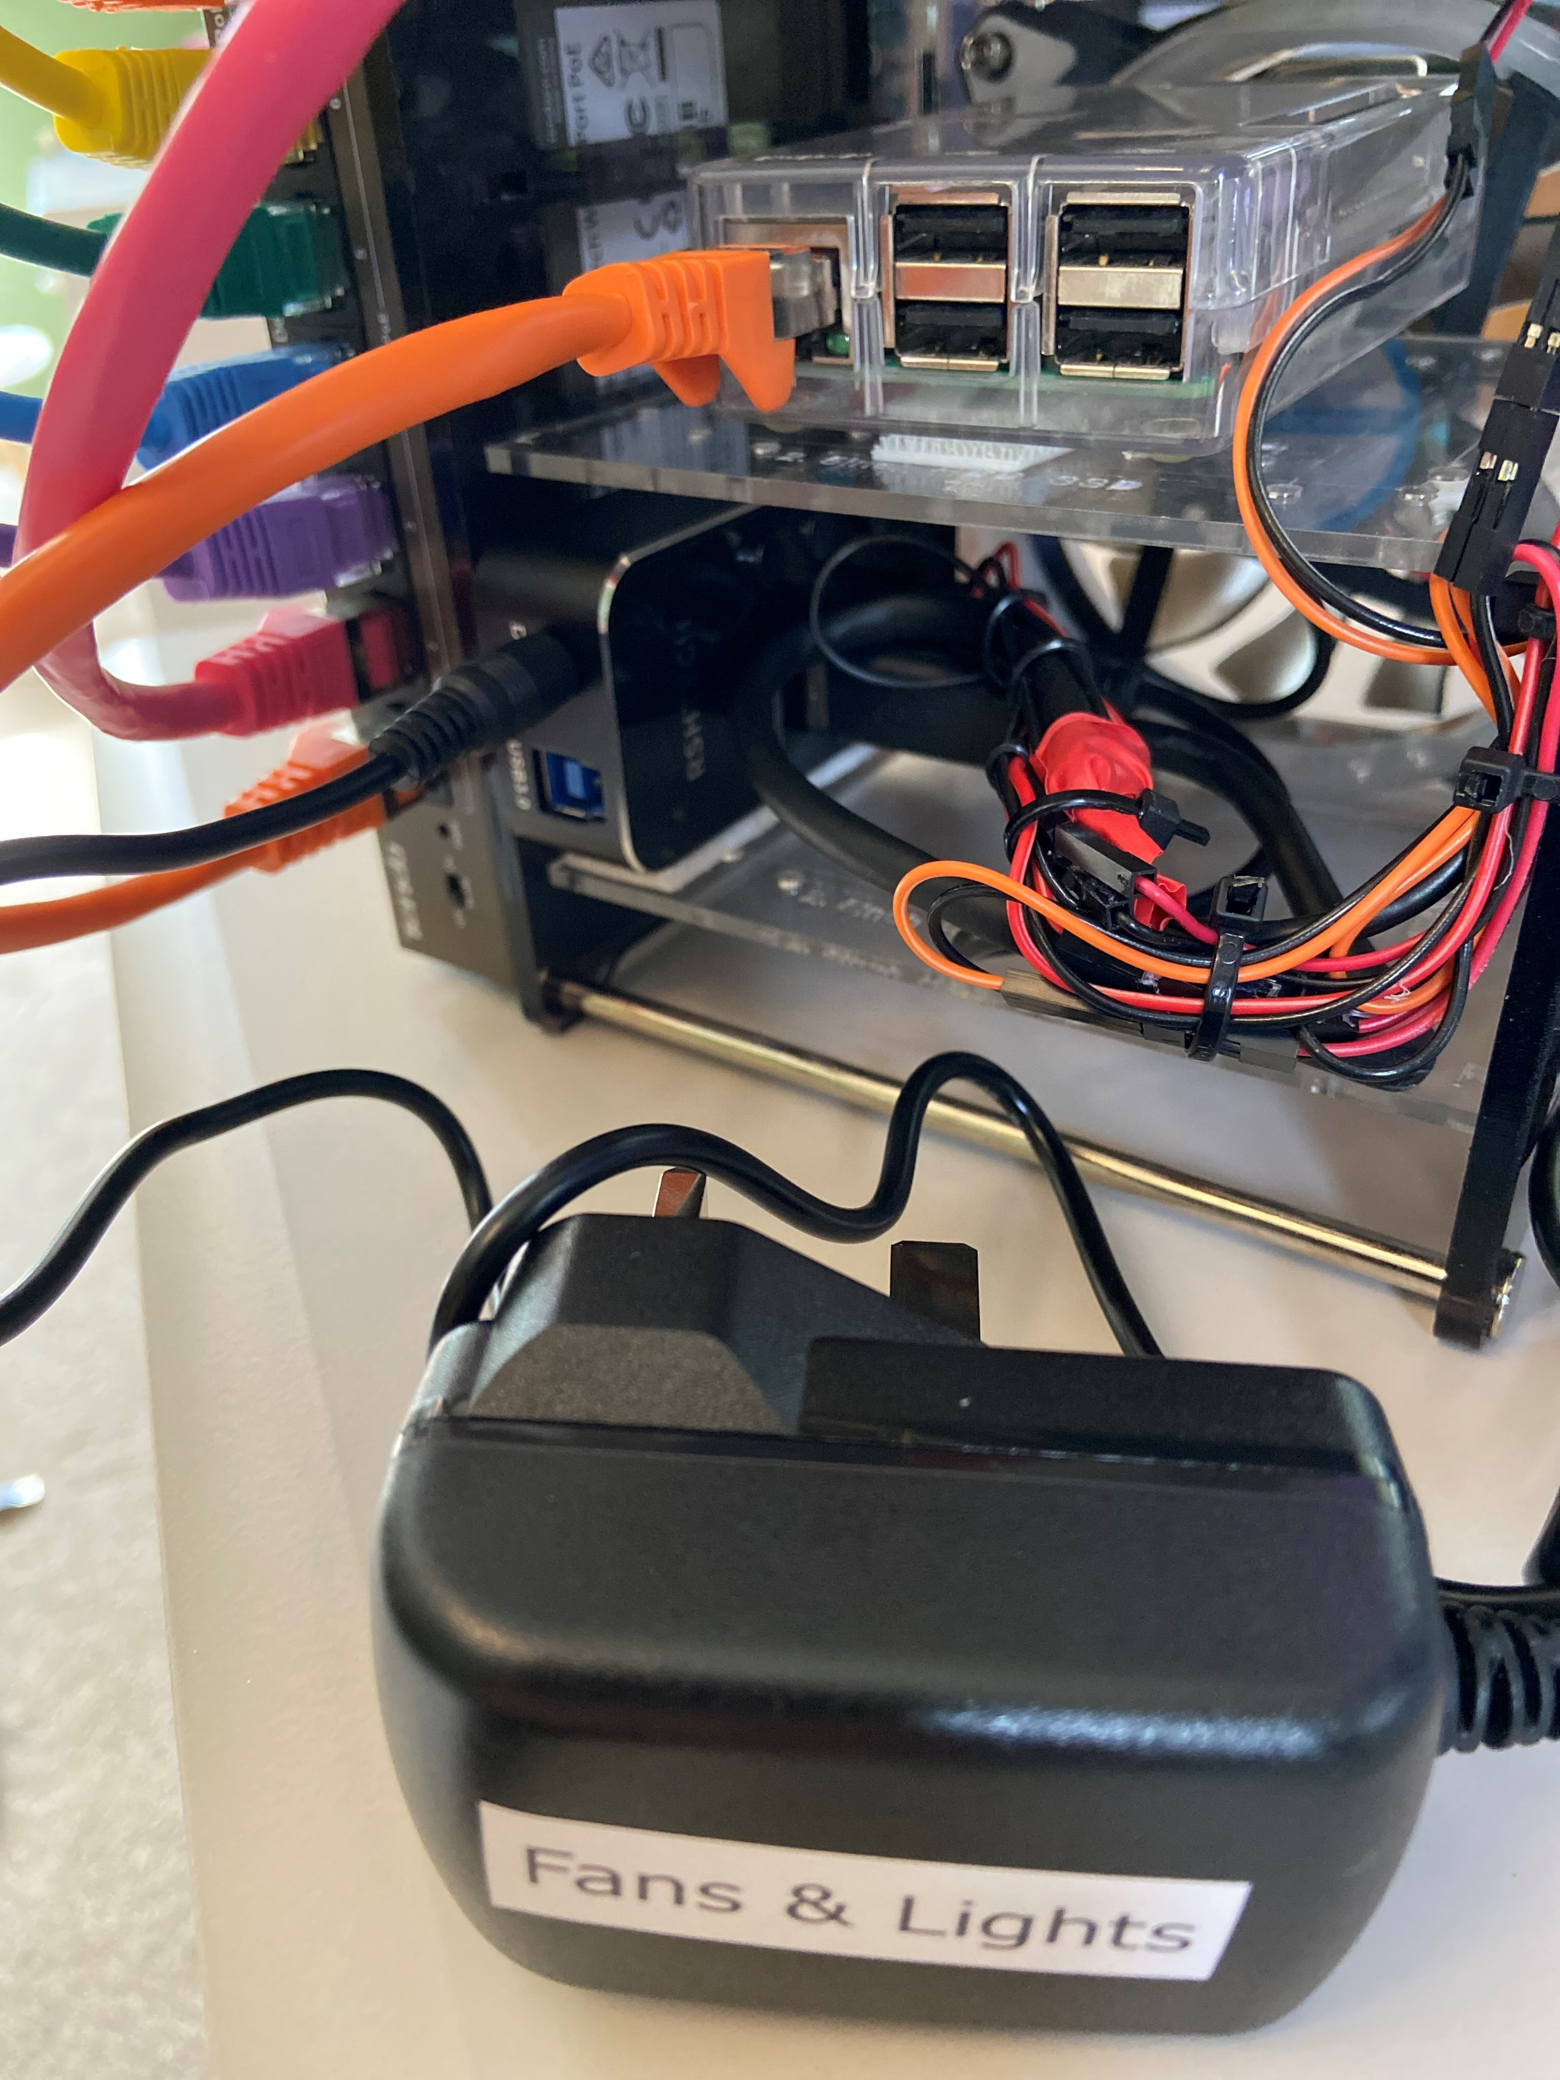
Plug-in fan/lights power supply
Lights and main fans will now come on

Slide 6
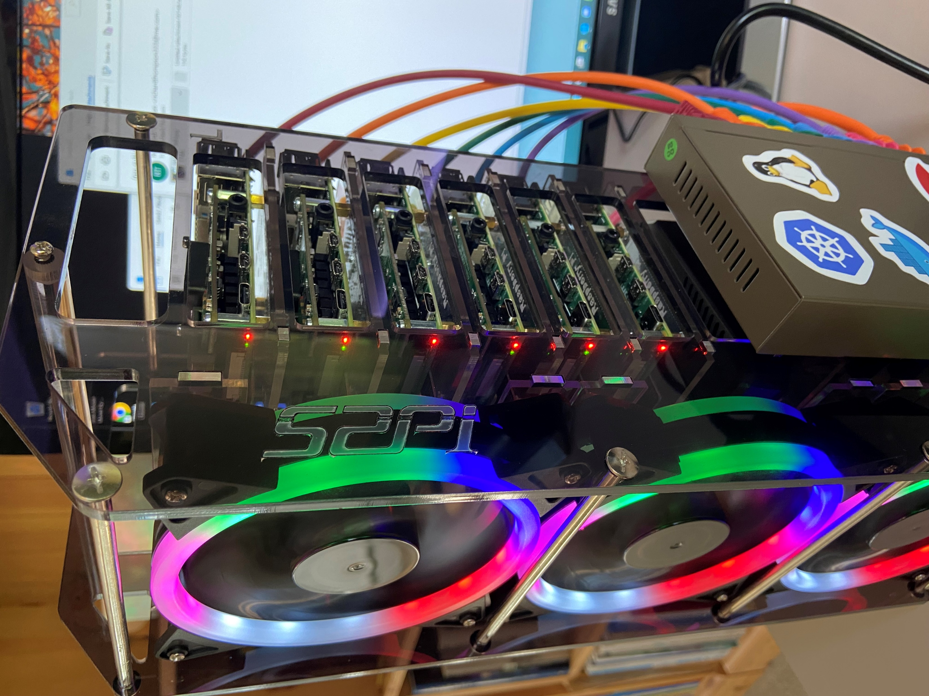
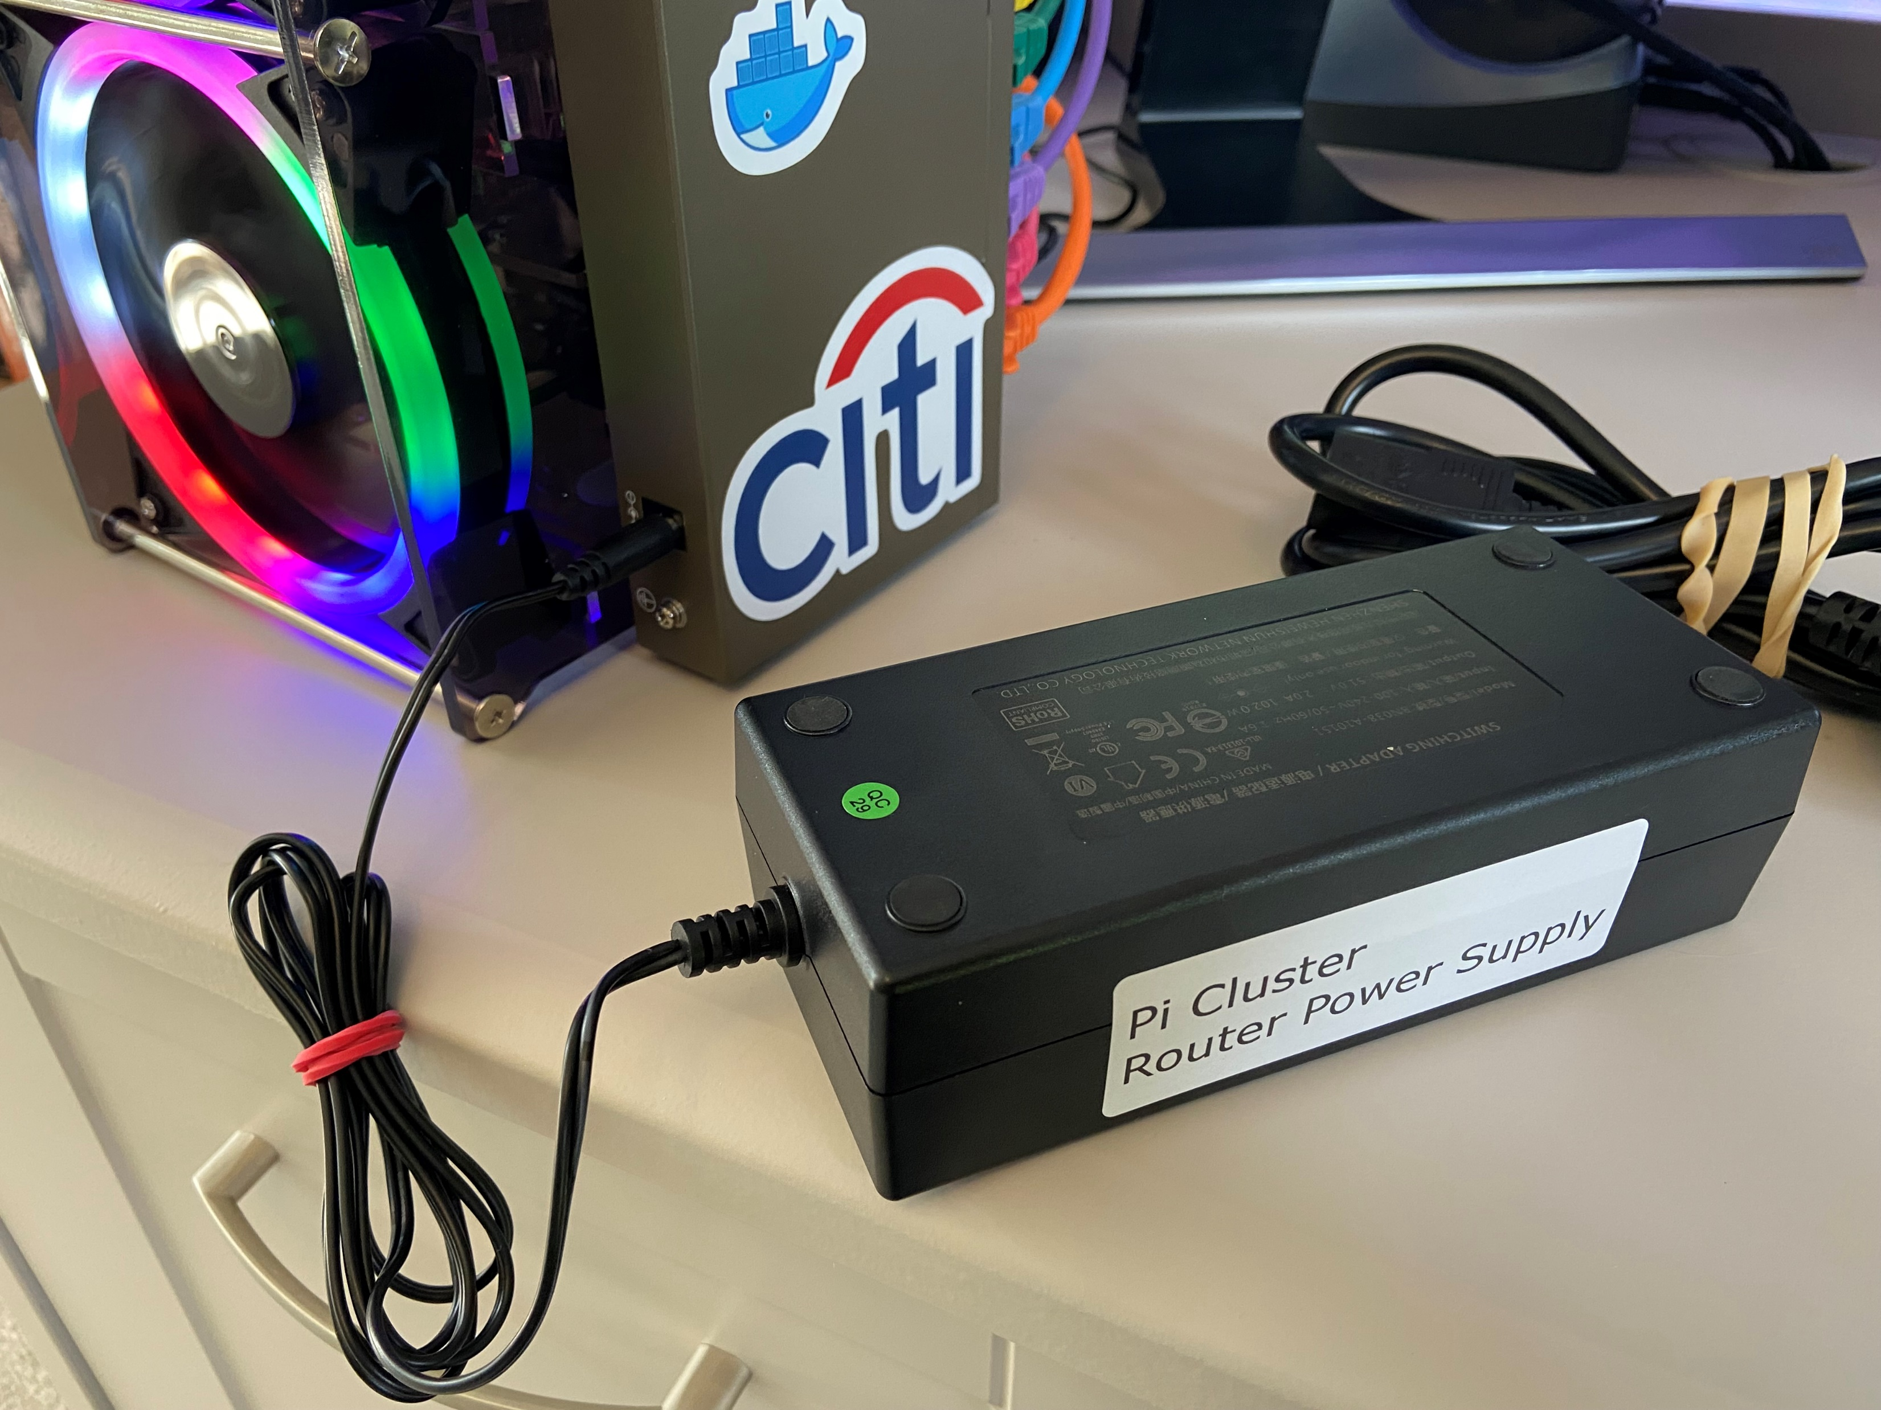
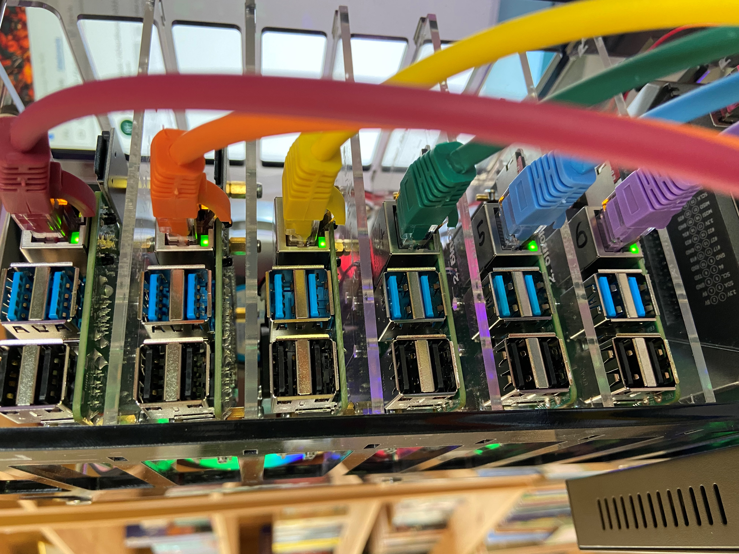
Worker Pi power lights visible
Connect switch/router power supply, this powers all the worker Pis through the ethernet CAT cables (POE).
Ethernet lights flashing

Slide 7
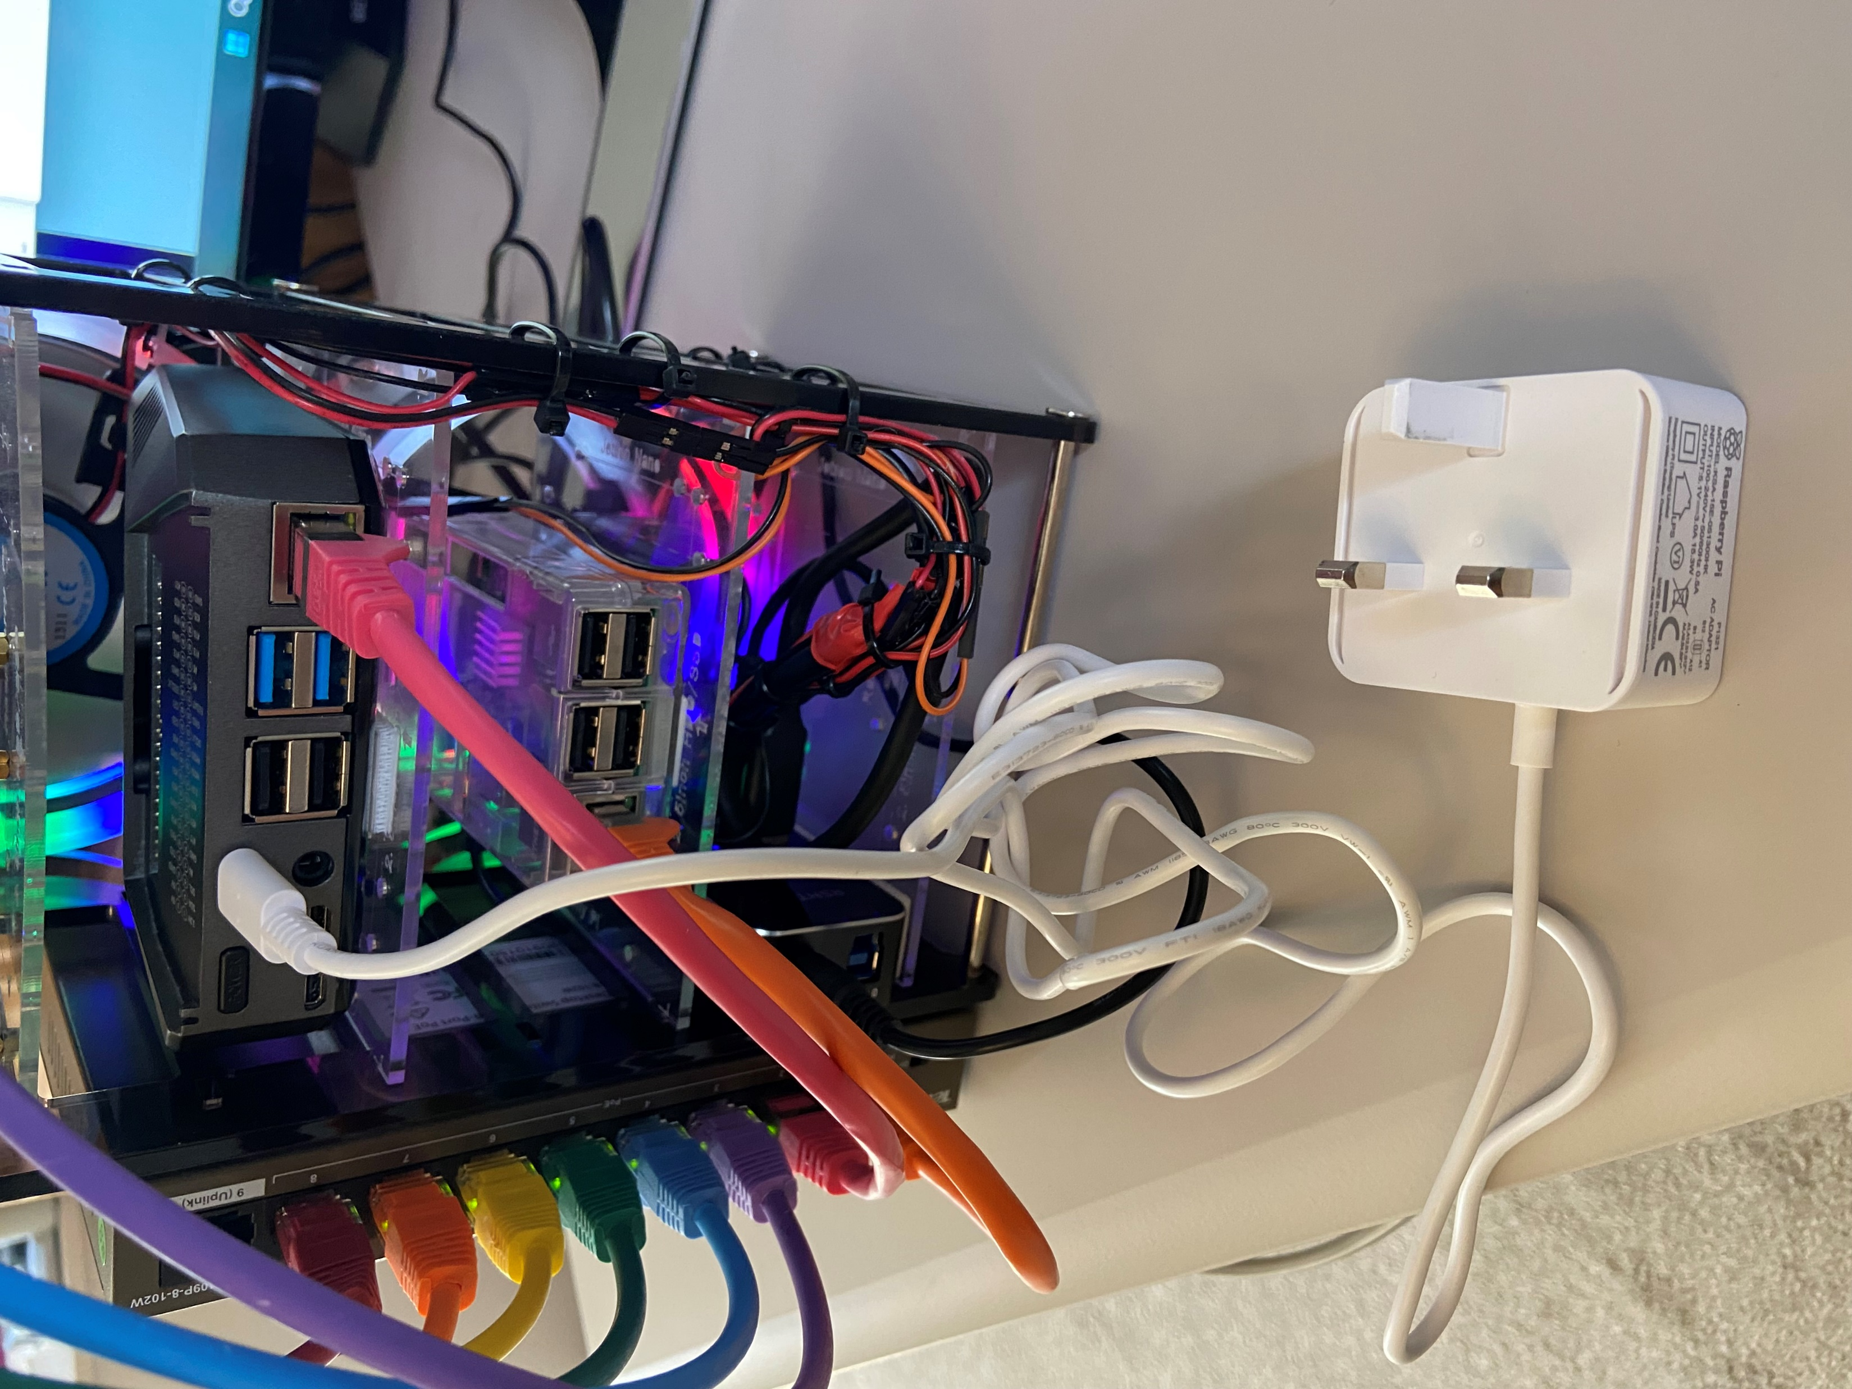
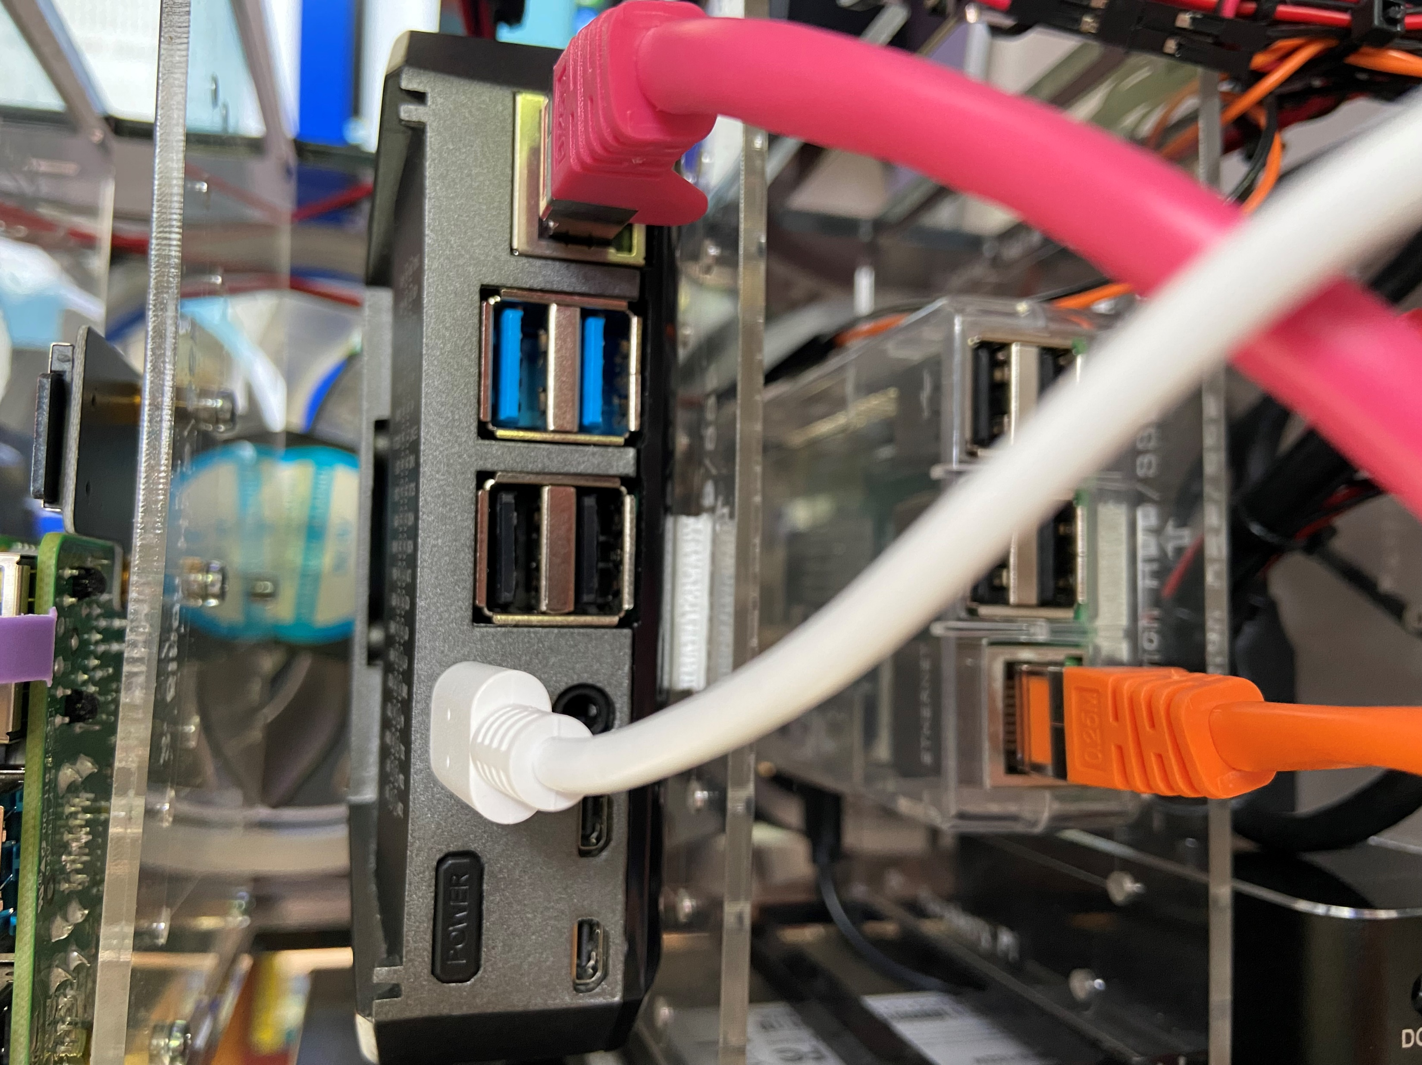
Connect USB-C power supply to Controller Pi
Power on Controller with this button

Slide 8
Software Setup

Slide 9




External Network
Cluster Network
Raspberry Pi
Host: worker-01
IP: 10.0.0.81
Raspberry Pi
Host: worker-02
IP: 10.0.0.82
Raspberry Pi
Host: worker-05
IP: 10.0.0.85
Raspberry Pi
Host: control-0
IP: 10.0.0.80
…
Laptop
POE Network Switch (L2)
Internet
Raspberry Pi
Cluster Router
(Gateway)
Router

Slide 10
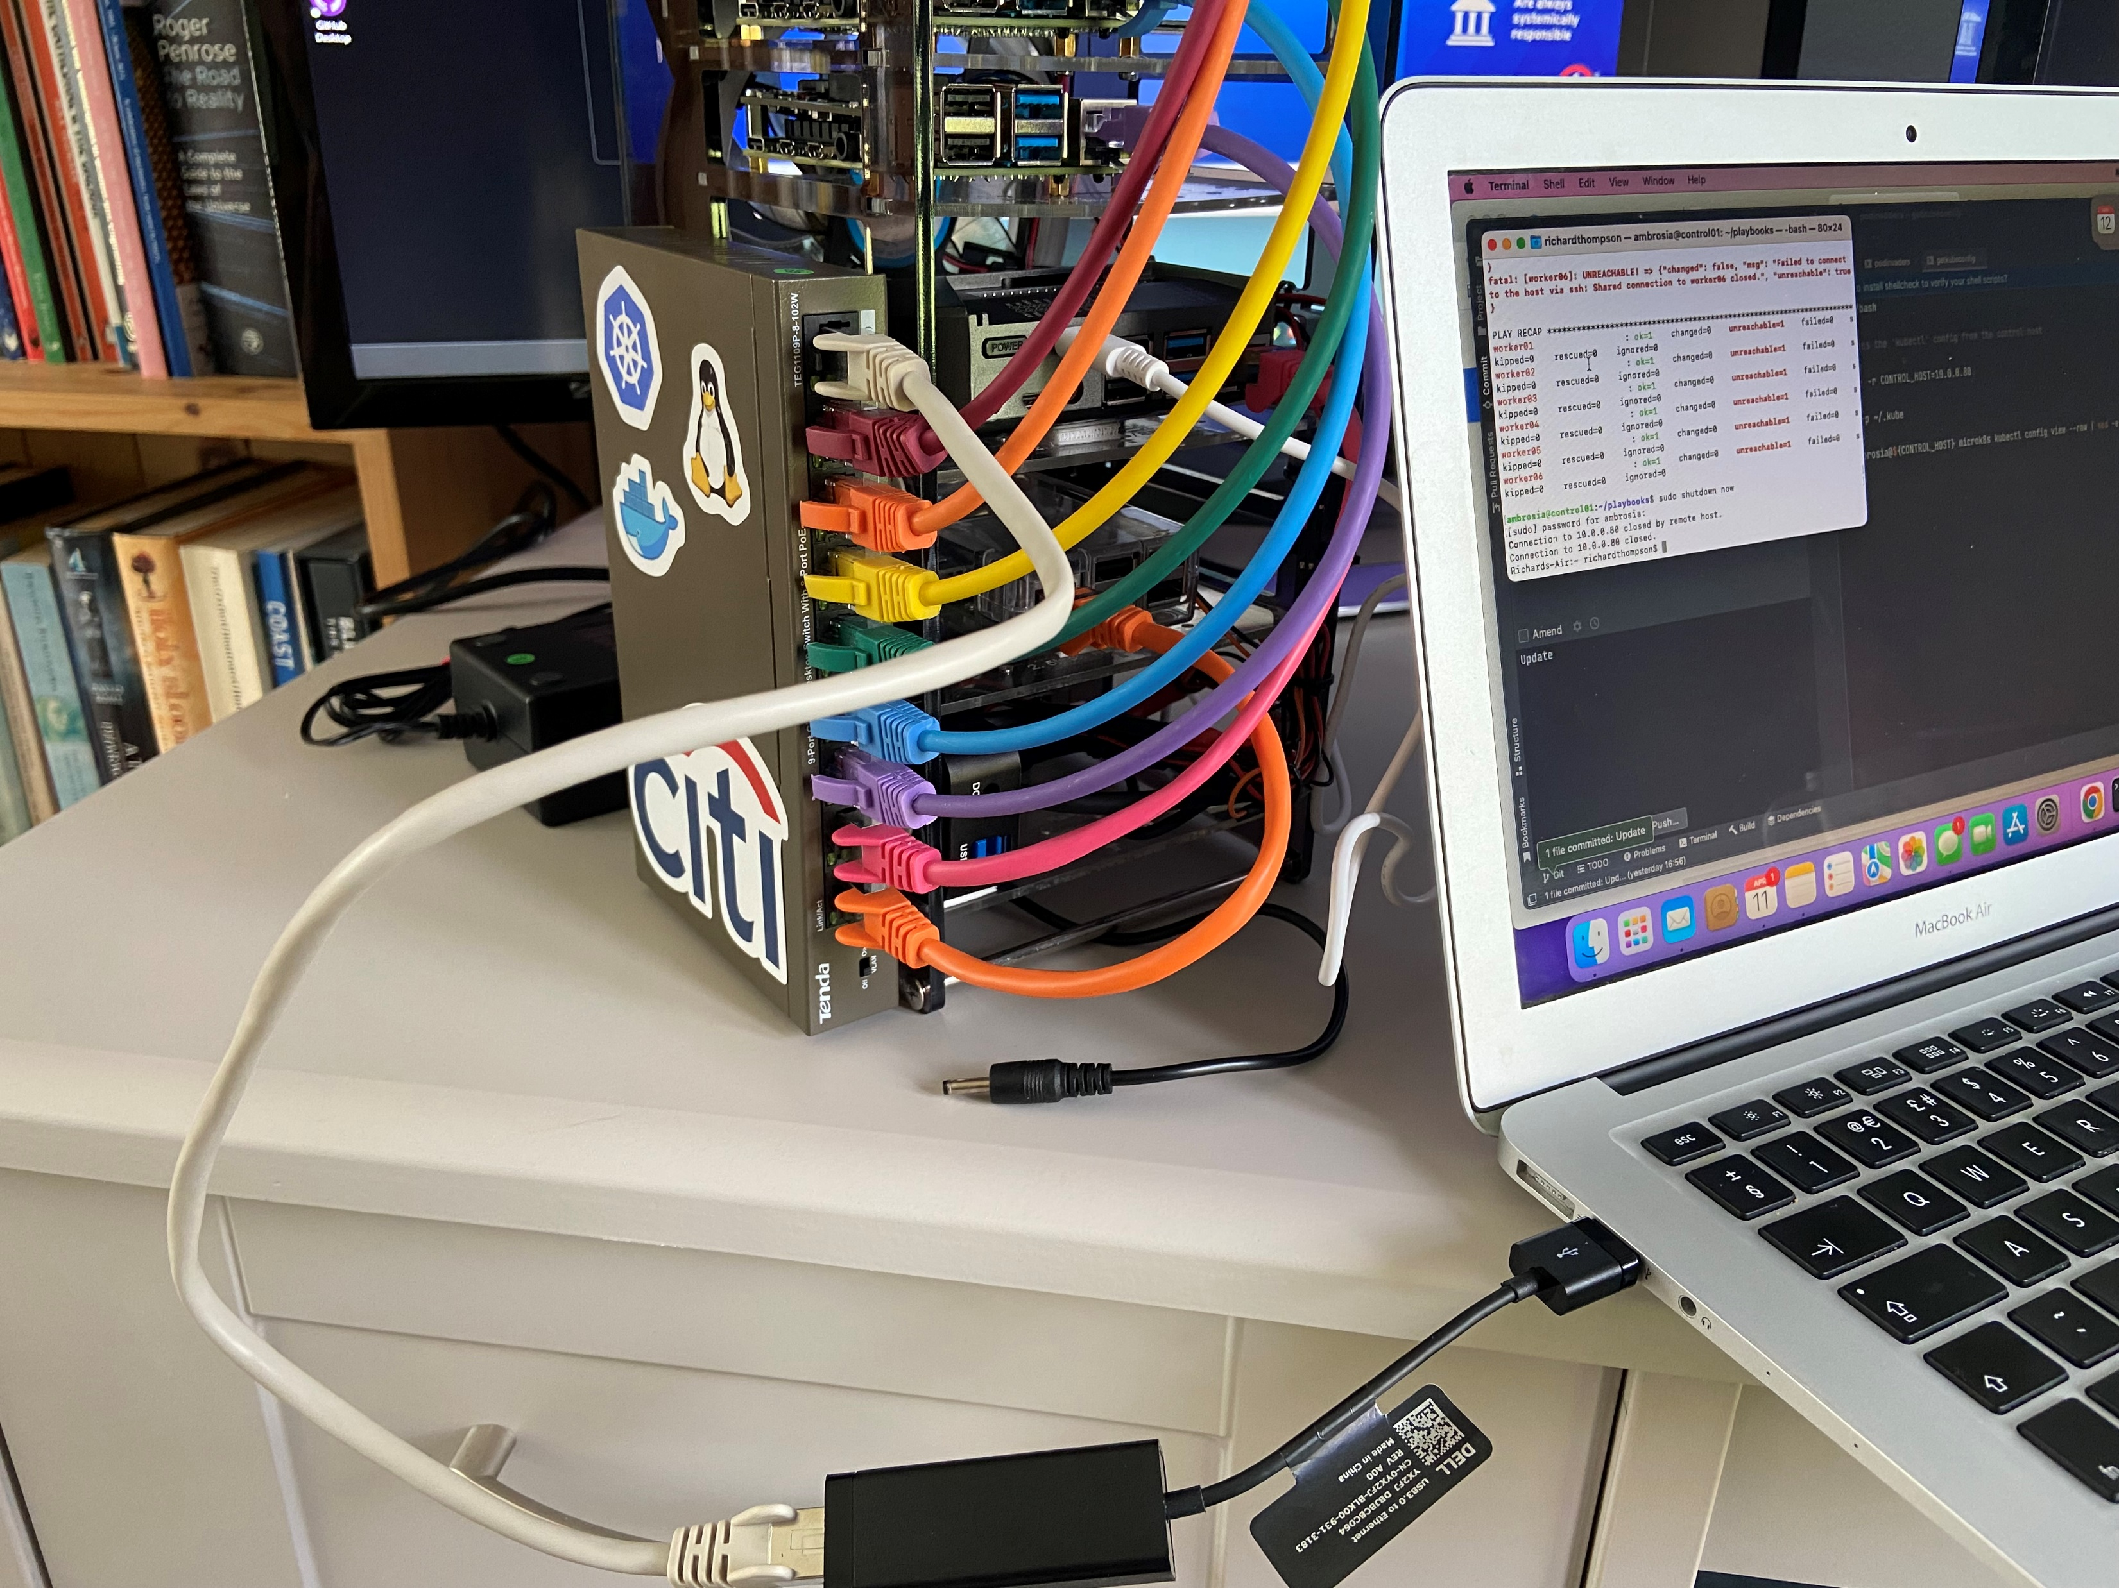
Connecting a Laptop to the Cluster
Laptop prerequisites
ssh client
Kubectl see https://kubernetes.io/docs/tasks/tools/
PodInvaders see https://github.com/thompsri/podinvaders
git
A laptop can be plugged into the top socket of the switch, i.e. the “uplink” socket. This will enable the laptop to have access to the cluster nodes using private/static IP addresses

Slide 11
Cluster Access from a Laptop
######################################### # From a terminal session on laptop ######################################### ######################################### # The password for ‘ambrosia’ is custard #########################################
> ssh-keygen
> ssh-copy-id ambrosia@10.0.0.80
> ssh ambrosia@10.0.0.80
Welcome to Ubuntu 20.04.4 LTS (GNU/Linux 5.4.0-1058-raspi aarch64)
* Documentation: https://help.ubuntu.com
* Management: https://landscape.canonical.com
* Support: https://ubuntu.com/advantage
System information as of Mon Apr 11 13:05:27 UTC 2022
System load: 1.06 Temperature: 32.6 C
Usage of /: 33.9% of 28.37GB Processes: 218
Memory usage: 16% Users logged in: 0
Swap usage: 0% IPv4 address for eth0: 10.0.0.80
######################################################################################## # We are on the controller node, a Raspberry Pi running Ubuntu and microk8s Kubernetes ########################################################################################
> kubectl get nodes -o wide
NAME STATUS ROLES AGE VERSION INTERNAL-IP EXTERNAL-IP OS-IMAGE KERNEL-VERSION CONTAINER-RUNTIME
worker04 Ready <none> 57d v1.23.5-2+b0aa1314369ebf 10.0.0.84 <none> Ubuntu 20.04.3 LTS 5.4.0-1058-raspi containerd://1.5.9 worker02 Ready <none> 57d v1.23.5-2+b0aa1314369ebf 10.0.0.82 <none> Ubuntu 20.04.3 LTS 5.4.0-1058-raspi containerd://1.5.9 worker03 Ready <none> 57d v1.23.5-2+b0aa1314369ebf 10.0.0.83 <none> Ubuntu 20.04.3 LTS 5.4.0-1058-raspi containerd://1.5.9 worker06 Ready <none> 57d v1.23.5-2+b0aa1314369ebf 10.0.0.86 <none> Ubuntu 20.04.3 LTS 5.4.0-1058-raspi containerd://1.5.9 worker01 Ready <none> 57d v1.23.5-2+b0aa1314369ebf 10.0.0.81 <none> Ubuntu 20.04.3 LTS 5.4.0-1058-raspi containerd://1.5.9 control01 Ready <none> 57d v1.23.5-2+b0aa1314369ebf 10.0.0.80 <none> Ubuntu 20.04.4 LTS 5.4.0-1058-raspi containerd://1.5.9 worker05 Ready <none> 57d v1.23.5-2+b0aa1314369ebf 10.0.0.85 <none> Ubuntu 20.04.3 LTS 5.4.0-1058-raspi containerd://1.5.9

Slide 12
Running Pod Invaders from a Laptop
##################################### # From a terminal session on laptop #####################################
> git clone https://github.com/thompsri/podinvaders.git
> cd podinvaders/install
################################################################################################# # This copies the ‘kubectl’ config from the controller node so we can use ‘kubectl’ on the laptop #################################################################################################
> ./getkubeconfig
> ./podinvaders

Slide 13
Shutting the Cluster Down
##################################### # From a terminal session on laptop #####################################
> ssh ambrosia@10.0.0.80
> cd playbooks
> ansible-playbook shutdown.yaml
> sudo shutdown now

Slide 14
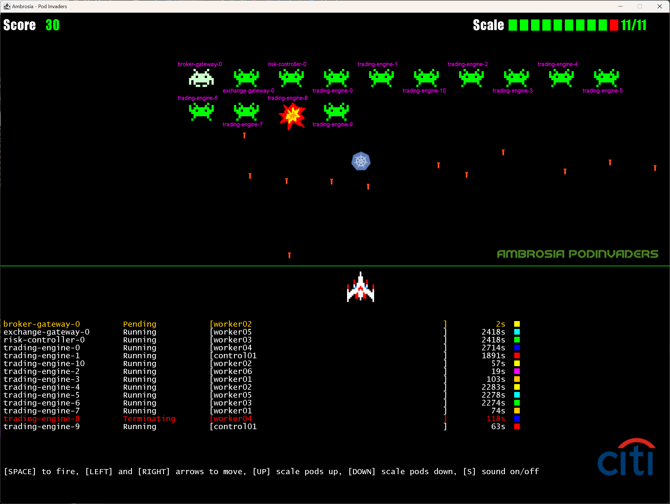
Pod Invaders

Slide 15
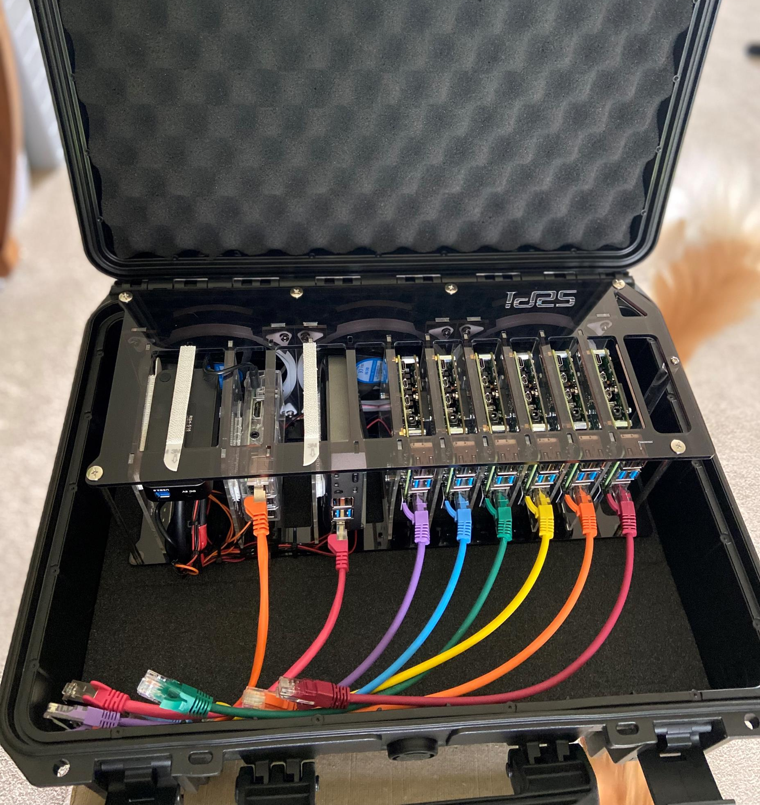
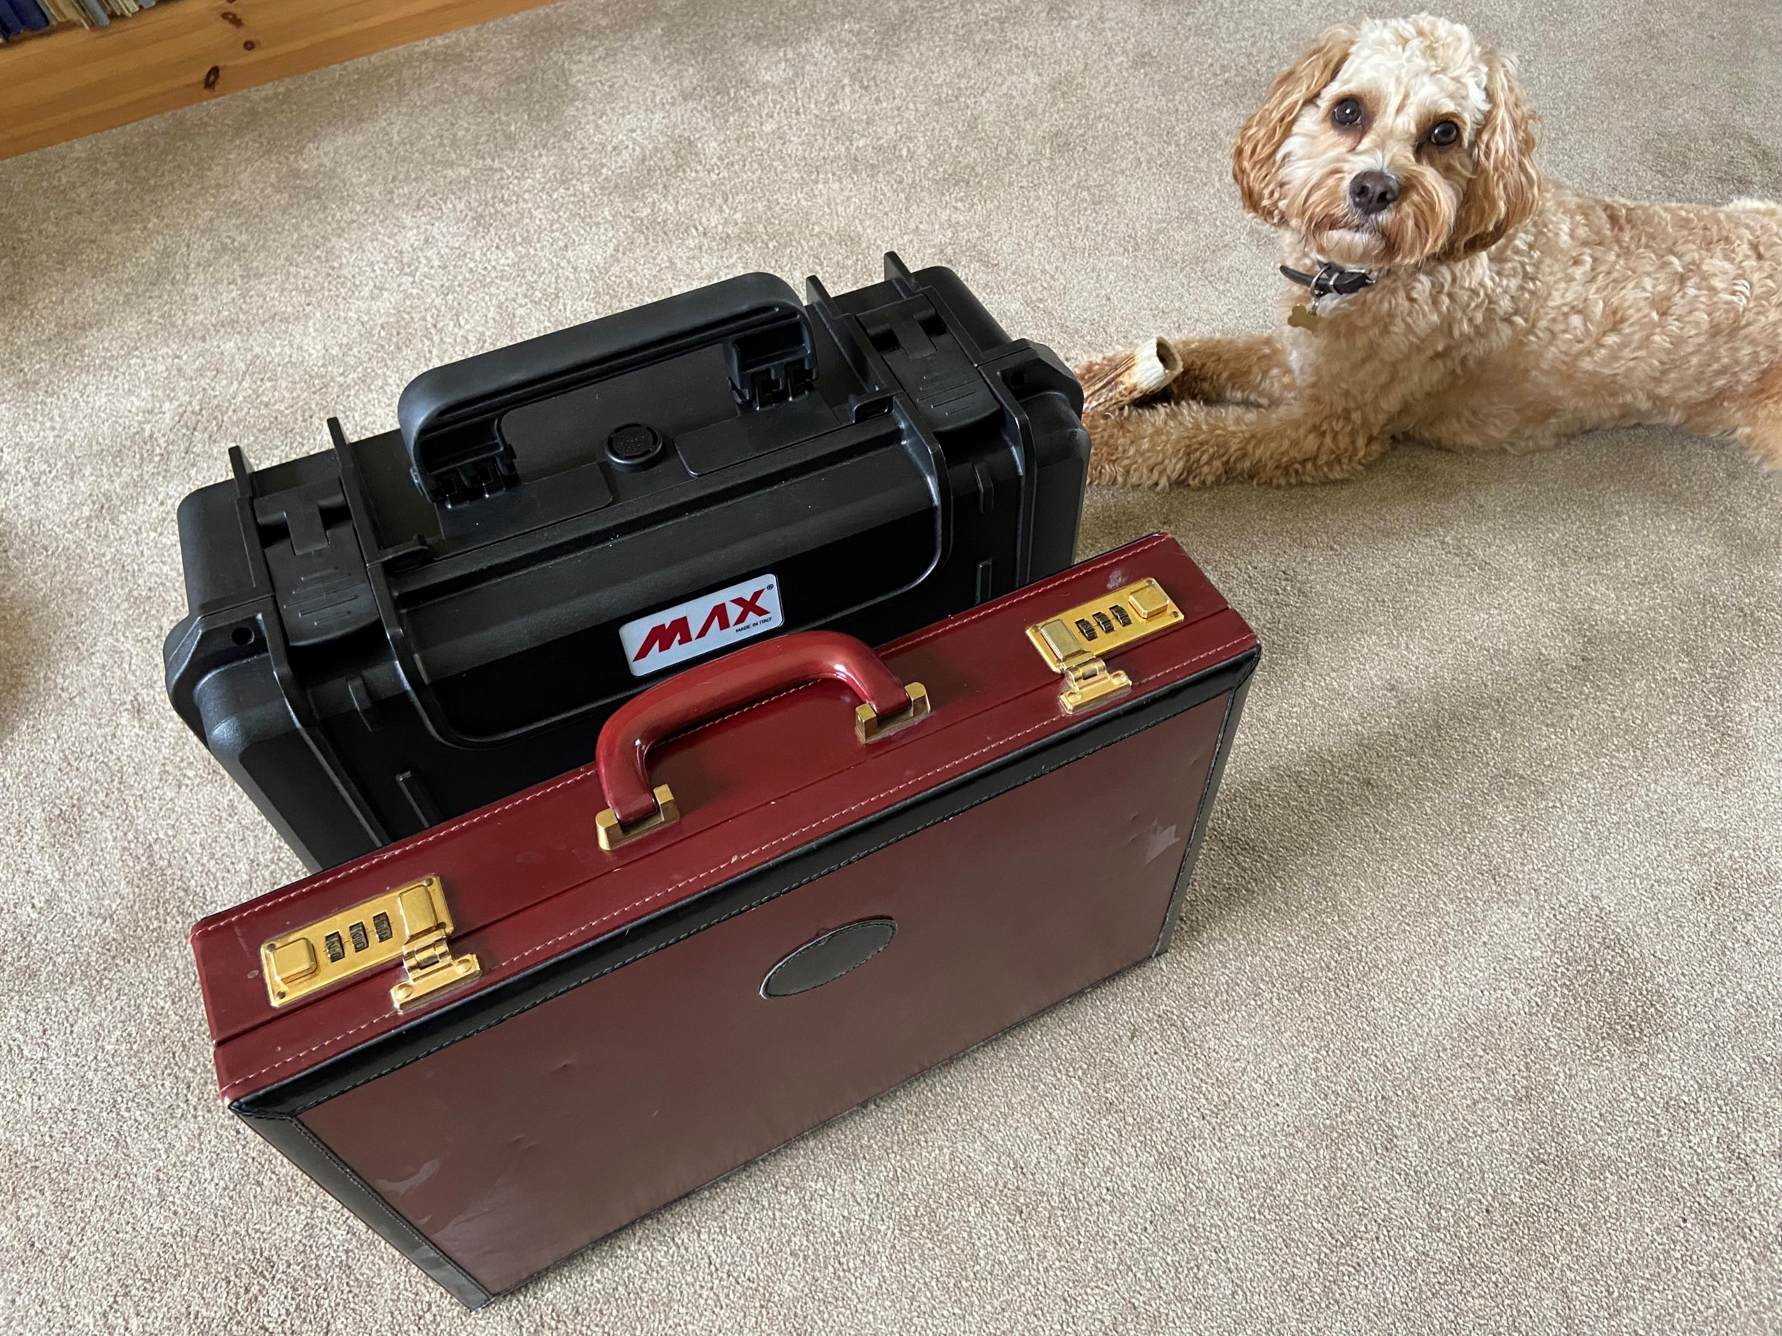
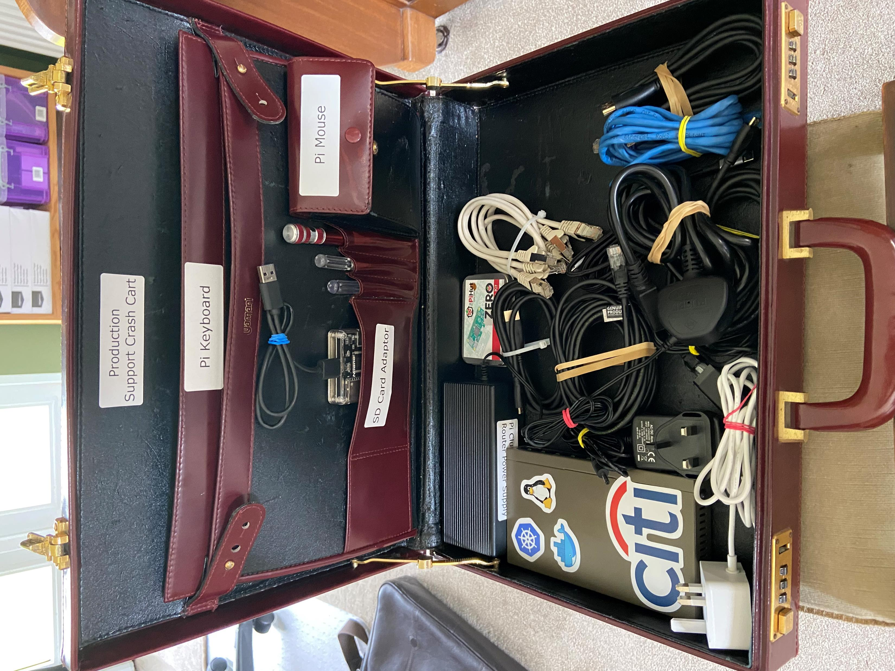
Broker in a Briefcase

Slide 16
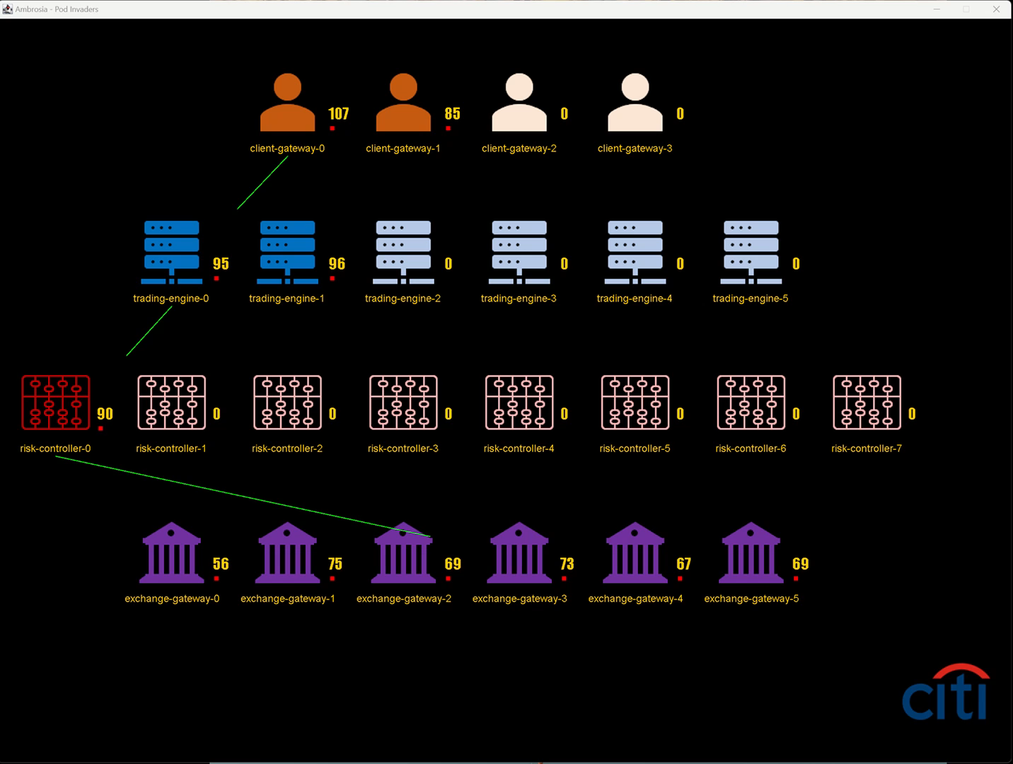
Trading Engine
Scaling Up Video

